Slide 1
会员快速指南：
后台导航和如何将有问必答部署到工厂
Notes:
Welcome to Member Quick Guide Video
In this video, we will teach you how to Navigate the Backend of Feedback Tool & How to Deploy Feedback Tool to Factory

Slide 2

必要的准备工作
列出你想部署RBA Voices的工厂清单。
发送电子邮件给工厂。邀请工人确认参与该计划，指定一名工厂联络员管理并推广该计划。
该联络员将收到反馈登录信息。如果RBA Online中列出的电子邮件不正确，您需要在后台系统中进行更改。 需要变更工厂联络员时，请参考阅读相关说明
查看视频：如何将工具部署到目标工厂
在快速登录指南中（第3步）
查看2个产品选项
并决定你想在工厂中部署哪一个。
2
Notes:
Before you start deploy, here are the few necessary preparations:
First, you will need a list of specific factory which you desire to deploy the Feedback Tool to
Second, Please go to RBA Online and check if the factory Point of Contact & their email address is correct. When you deploy tool to the factory, the system will send the Tool Onboarding Email to this address
(show onboarding email to factory)
Third, review deployment video at _____
Forth, review 2 Product Options & make a decision on which one you would like to deploy to factory

Slide 3
查看2个产品选项
根据成员决定，部署产品1或2，
工厂将收到一个带有相应产品选项的二维码
产品1：完整的应用程序
产品2:单一反馈工具
扫描二维码后，工人可结合提示安装RBA Voices应用程序
其中包括多项功能：
有问必答工具
调研
工人学习学院
推荐给工人人数较多的地方
拥有成熟数字化人力资源部门
的供应商。
扫描二维码后，工人将被引导进入一个网络浏览器，其中只包括：
只有有问必答工具
这种单一功能的二维码为RBA成员
提供了一个可扩展的选择。
推荐给那些没法添加学习或调研内容的地方。
Notes:
Depending on Member’s decision to either deploy Product 1 or 2,
the Factory will receive a QR Code with the corresponding product option

Slide 4
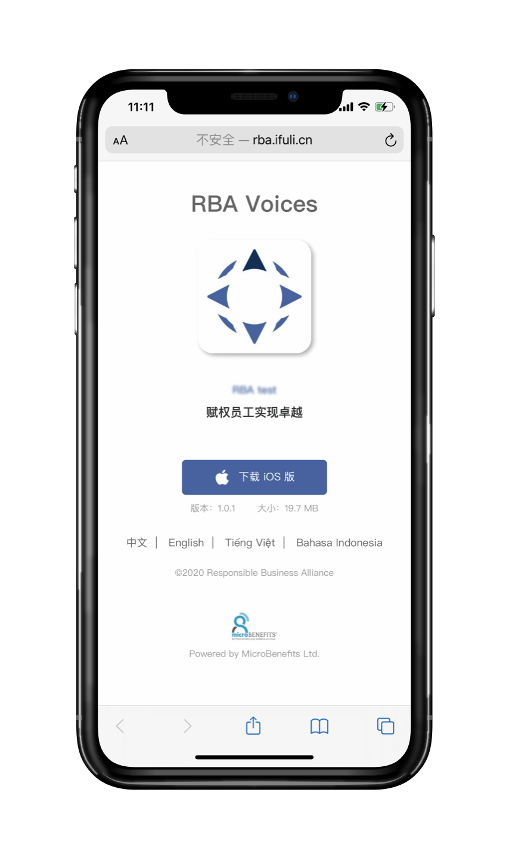
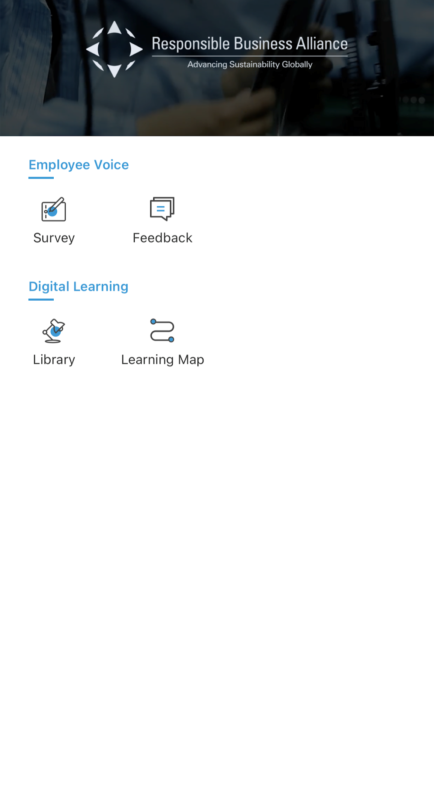
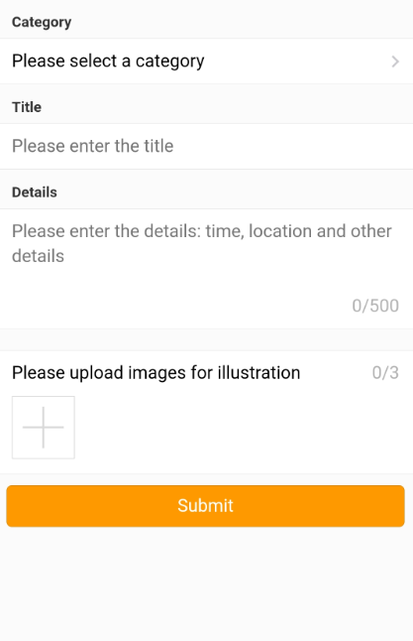

产品选项1:完整的应用程序(强烈推荐)
扫描二维码后，工人将结合提示安装RBA应用程序
允许工人安装RBA Voices应用程序，享受完全集成的：有问必答工具、调研工具和工人学习学院。
关键功能：
多种功能
使用员工号或手机号轻松登录/注册
快速、方便地检查反馈状态和查看工厂回复
Notes:
Product 1: Full App
Allows worker to install the RBA Voices App and enjoy the fully integrated:
Feedback Tool
Survey Tool,
and
Worker Learning Academy
This option is highly recommended for locations with larger worker populations and suppliers that have mature, digitized HR departments
Its Key Value are
Multiple features
Easy sign in / sign up using employeeID or cellphone number
Quick & easy checking of Feedback status & viewing of factory response

Slide 5
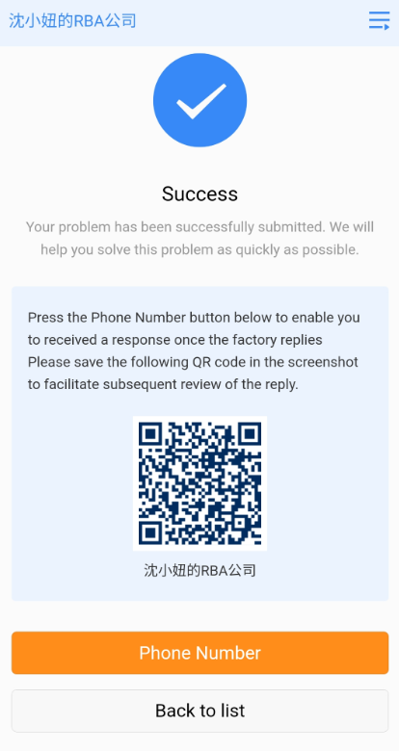
产品选项2:单一有问必答工具(可选)
扫描二维码后，工人将被引导到有问必答工具网页
允许工人快速访问有问必答工具
要求工人提供电话号码，以便在工厂作出答复时收到短信通知
要求工人扫描一个新的二维码，检查/查看工厂答复内容
关键功能：
无需安装应用程序
快速、简单提交反馈内容
Notes:
Product 1: Single Feedback Tool
Allow worker to have quick access to a webpage, which only include the Feedback Tool
This single function QR code is recommended for use in locations that do not have the capacity to add learning or survey content
Its Key Values are:
No app installation is required
Quick & easy Feedback submission
However, it will require worker to provide phone number in order for worker to receive SMS notification whenever the factory response

Slide 6
后台导航
Notes:
As you have completed the necessary preparation, let’s access to the Feedback Tool Backend

Slide 7
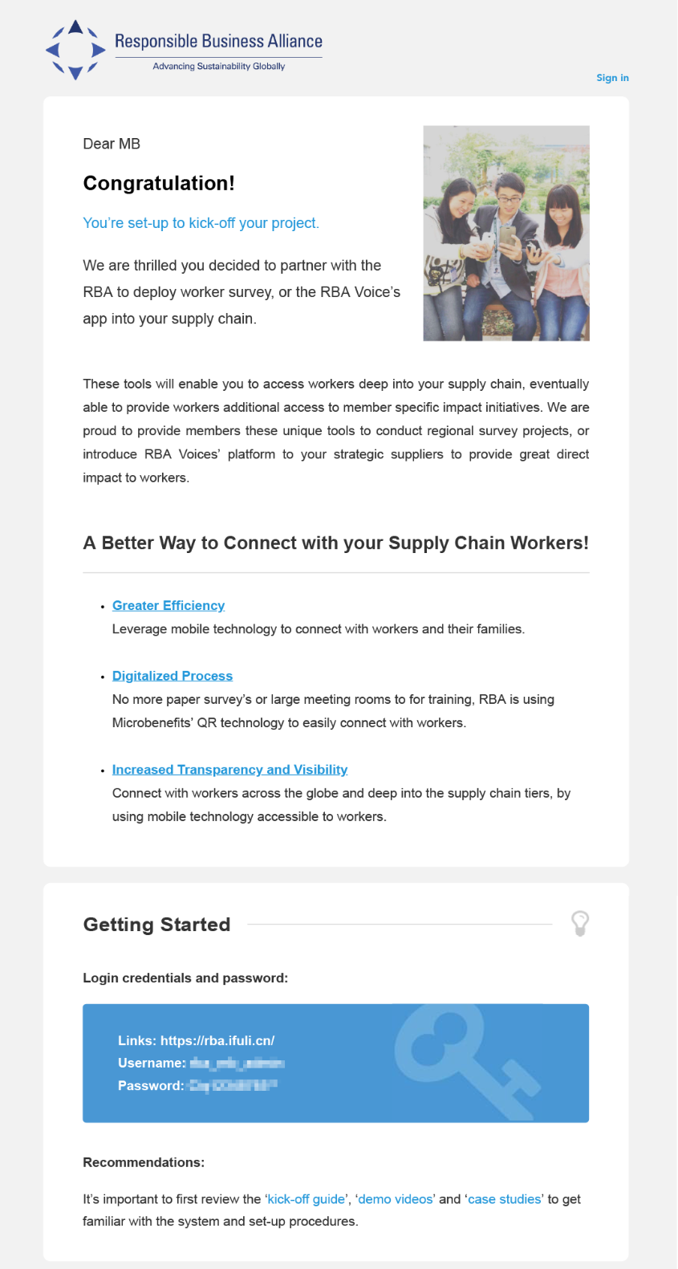
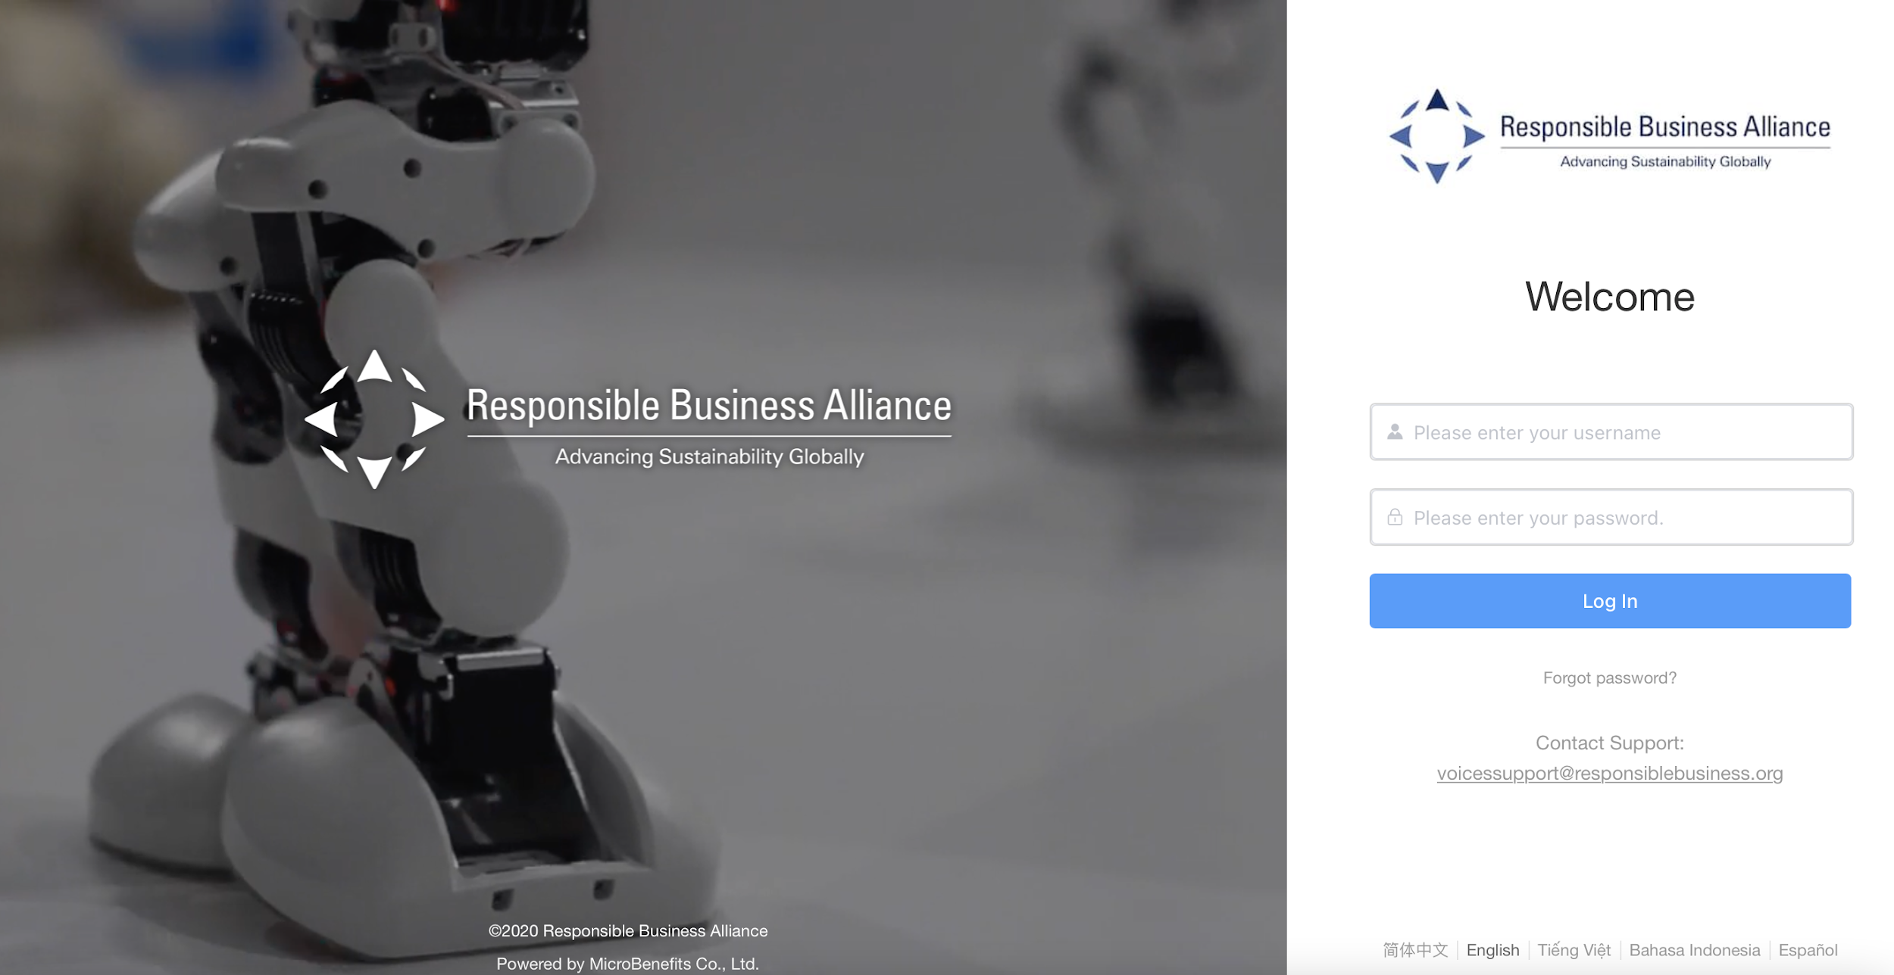

后台登录
第1步：访问后台并通过登录账号登录
登录账号
登录账号通过电子邮件发送给您
Notes:
Login to the Backend.
On the Onboarding Email, you will receive the Login Credentials. This is the login account to the Backend - a website which allows you to manage this tool.
(show a sample of Onboarding email for Member, point to the Login credentials)
The URL Link to access this Backend can be found at the last step on the Onboarding Quick Guide.
(show the last step of Onboarding Quick Guide, point to the Backend URL link)
What you’ll need to do is click on the Backend URL link, then enter your Username & Password.
Click on [Log in]
(show login page of Backend)

Slide 8
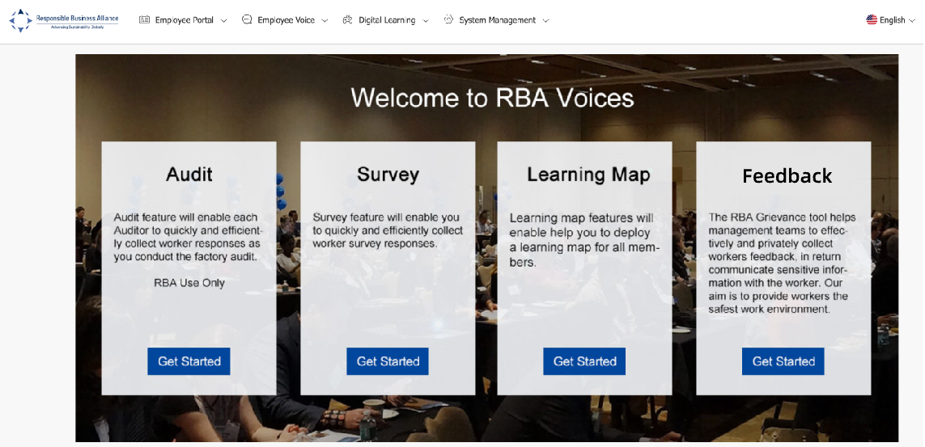
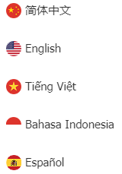
后台登录
第2步：在【有问必答】部分->点击【开始】
如果您希望以不同的语言查看后台，请点击这里
可用语言
Notes:
Here on this page, if you wish to view the backend in another language, please click on this icon on the top right of the screen.
Current available languages are Simplified Chinese, English, Vietnamese, Bahasa Indonesia, Spanish
(point to the icon & language choices)
Next, at the [Feedback] section, click [Get Started]

Slide 9
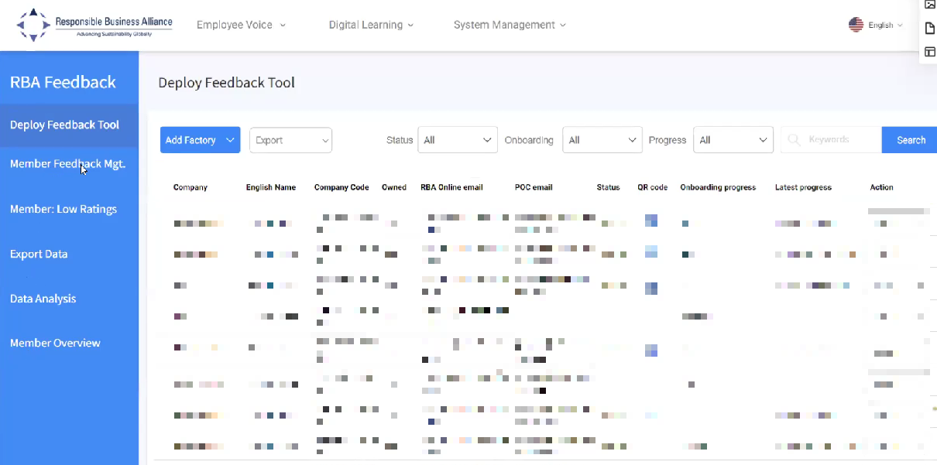
后端功能
在左边一栏，可看到与有问必答工具使用相关的多个功能：
条款说明：
部署有问必答工具：可将有问必答工具部署到特定的工厂。
会员反馈管理：工厂工人提交的反馈的详细信息。
会员：低评级：低评级反馈的细节。这是为了衡量工人在收到工厂的反馈后的满意度。
导出数据：下载反馈的详细信息的位置
升级：由工人上报的反馈的细节
会员概述：按工厂或国家划分的反馈分析报告
Notes:
Start from 3:10’ of the video
On the left column, you will find multiple features related to the Feedback Tool
(click on each tab)
Deploy Feedback Tool: Where you can deploy the Feedback tool to specific factories.
Member Feedback Mgt: Details of the Feedback submitted by workers in your factory.
Member: Low Ratings: Details of low-rated Feedback. This measures worker satisfaction after receiving Feedback from the factory.
Export Data: Where you download the details of feedback
Escalation: Details of the Feedback escalated by the workers.
Member Overview: Analysis report of Feedbacks by factory or country.

Slide 10
如何向工厂部署有问必答工具
Notes:
Next, we will learn how to deploy the feedback tool to the factory

Slide 11
快速流程
访问RBA有问必答工具
选择“部署有问必答工具”
选择“添加工厂” 备注：上传公司徽标
选择首选产品：“全部应用程序”或“单一有问必答”功能
选择“发送电子邮件”
工厂将完成问卷调查，并指定工厂联系人
系统将向工厂联系人发送激活电子邮件
管理员将访问后端来接收和回复工人的询问
更多问题或意见，可发送邮件至：VoicesSupport@responsiblebusiness.org

Slide 12
部署有问必答工具的两种方法：
方法A：专为尚未与工厂团队就RBA有问必答工具进行预先沟通。或者没有工厂管理员的联系信息的会员而设计。（首选）
方法B：专为已经与工厂领导团队就RBA有问必答工具进行过沟通，并拥有有问必答管理员联系信息的会员而设计。
Notes:
There are 2 methods for member to deploy the feedback tool
Method A: is designed for Member who have NOT yet pre-communicated with factory teams about the RBA feedback tool. Or don’t have the factory Feedback manager POC contact information. (preferred)
Method B: is designed for Member who HAVE already communicated with factory leadership teams about the RBA feedback tool and have the Feedback manager contact information.

Slide 13
部署方法A：
方法A专为尚未与工厂团队就RBA有问必答工具进行预先沟通的会员而设计。此部署方法可协助向工厂发送一份正式的邀请，其中将包括信息和背景信息。
“允许工厂同意或不同意”引入反馈工具，并为有问必答工具的优点介绍提供具体案例研究。
工厂团队将指派管理员负责激活和项目管理
Notes:
First, let’s look at the Deployment method A: This is designed for Member who have NOT yet pre-communicated with factory teams about the RBA feedback tool. This deployment method will assist you to send a formal invitation to your factories that will include with information and background.
Allows for Factory to Agree or Disagree to introduce the Feedback tool, and will provide case studies to the benefits.
Factory team will assign Feedback manager Point of Contact for onboarding and program management

Slide 14
第1步：点击【部署有问必答工具】
在第一次登录时，该页面为空白。对于您【添加工厂】，该列表将填充FTY名称及其状态。
公司代码：根据“RBA在线”提供的工厂代码
所有权：工厂是否属于会员所有
“RBA在线”电子邮件：工厂联系人的电子邮件。工厂联系人的电子邮件可能是工厂管理员的电子邮件，也可能不是。
POC电子邮件：工厂管理员的电子邮件。当有问必答工具部署到工厂时，系统将向此帐户发送一封激活电子邮件。
Notes:
(Step 1)
On the left column, click on [Deploy Feedback Tool]
This page is blank during the first log-in. As you “add factory” the list will populate with FTY names and their status.
Company Code: Code of the factory according to RBA Online
Owned: If the Factory is owned by the Member or not
RBA Online Email: Email of factory’s contact person. This may or may not be the email of the factory’s feedback manager.
POC Email: Email of factory’s feedback manager. When the Feedback Tool is deployed to the factory, the system will send an Onboarding Email to this account

Slide 15
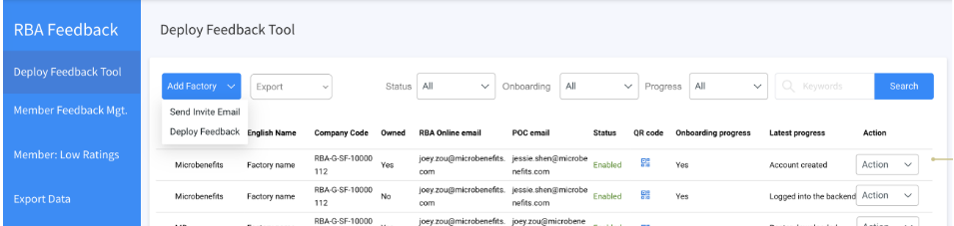
第2步：编写邀请函电子邮件
首先点击【添加工厂】
其次选择【发送邀请电子邮件】
Notes:
(Step 2)
Click on [Add Factory] , then Select [Send Invite Email]

Slide 16
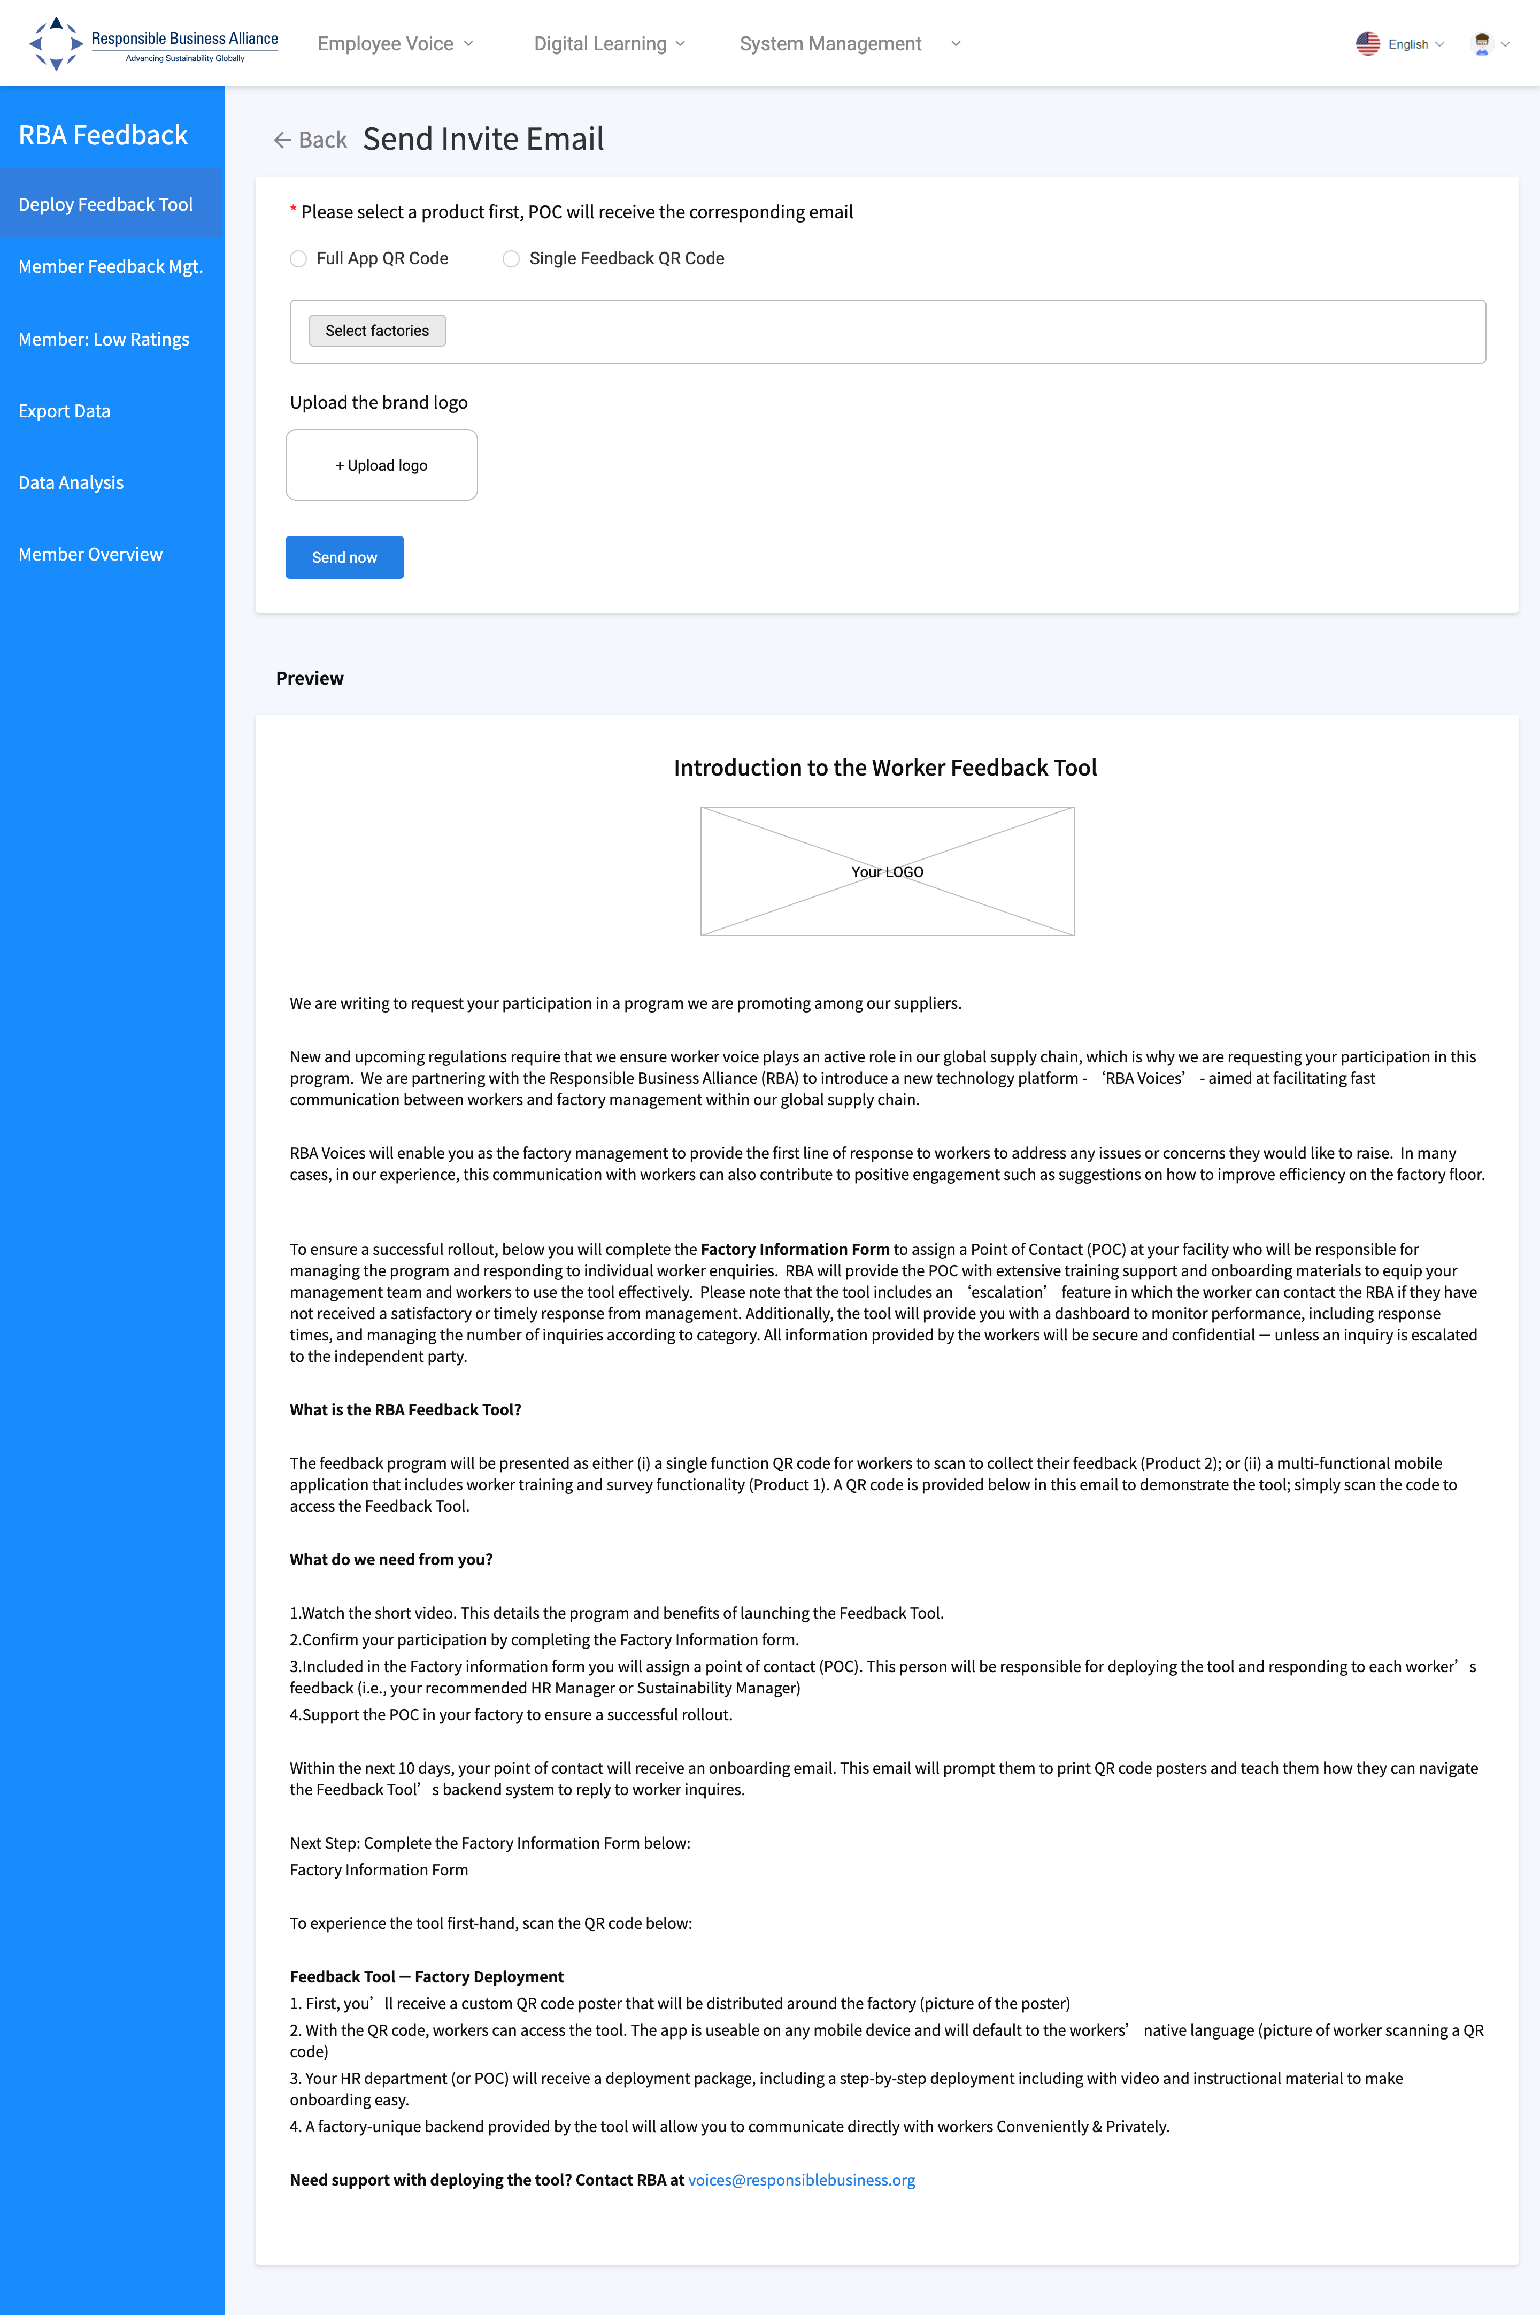

邀请函
邀请函电子邮件将包括：
添加自己公司的徽标
简要介绍RBA有问必答工具及其优点
工厂调查问卷，提供更多的细节，并分配一个有问必答管理员
接到该电子邮件之际，
工厂需要点击所提供的链接
并填写《分配有问必答管理员》。
请注意该URL有效期仅为20天。如果超出该20天的期限，会员可再次向工厂发出第二份邀请函。
Notes:
The Invite Email will include:
Add your company logo
Brief introduction to the RBA Feedback Tool and the benefits
Questionnaire for factory to provide more details and to assign a Feedback Manager POC
Upon receiving this email, the factory will need to click on the given link & complete an Assign Feedback Manager POC form.
Please note that this URL only valid for 20 days. If later than 20 days, Member can send another invite to the factory again.

Slide 17
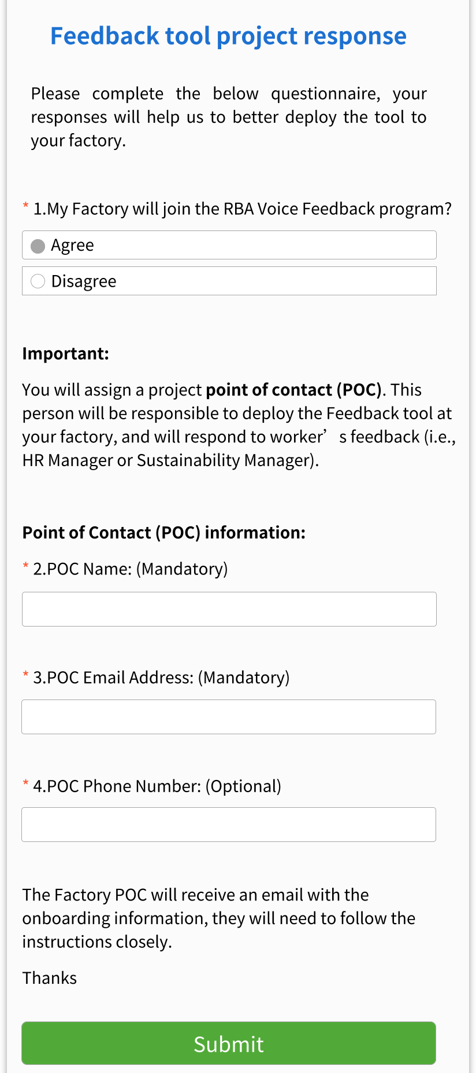
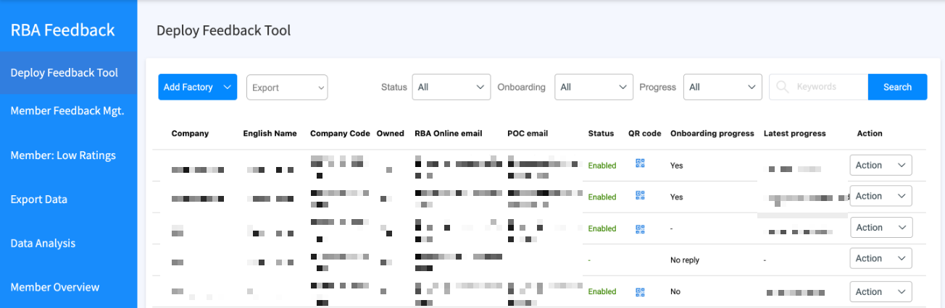
邀请函问卷
问题1：我的工厂可加入RBA Voice有问必答计划吗？
“同意”，系统自动将带有帐户凭证的激活电子邮件发送到POC的电子邮件地址（见问题3）。
“不同意”，系统将继续问有关工厂已有工具、工具类型或其他原因不能加入该计划方面的其他问题。
注：进度和回复跟踪可以在“部署有问必答工具”上找到。
Notes:
Base on the answer of the Factory on this form, the system will send out the Feedback Tool Onboarding Email
Question 1. My factory will join the RBA Voice Feedback program?
If the factory choose ‘AGREE’, the system will automatically send the Onboarding Email with the account credentials to the POC email address (see Q#3).
In case factory choose ‘DISAGREE’, the system will continue to ask additional question of factory already has a tool, they type, or other reasons for not joining the program.
Progress and response tracking can be found at “Deploy Feedback tool”.

Slide 18
第3步：选择产品类型
选择产品1-全部应用程序二维码或产品2-单一有问必答二维码
Notes:
(Step 3)
Select Product 1 – Full App QR Code or Product 2 – Single Feedback QR Code

Slide 19
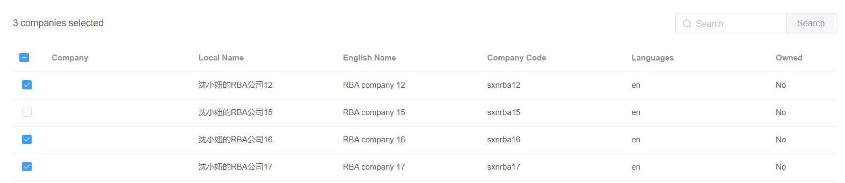
第4步：选择工厂
点击【选择工厂】
B、通过点击工厂名称旁边的“复选框”选择想要发送邀请函电子邮件的工厂。
Notes:
(Step 4)
Click [Select Factories] & select the factories which you would like to send invite email to by clicking on the checkbox beside the names of the factories

Slide 20
第5步：上传徽标和发送邀请函
A、从自己的电脑上点击【上传徽标】并选择PGN或JPG格式的公司徽标。
B、点击【现在发送】将邀请函电子邮件发送至各个工厂，并部署工具。
在此步骤之后，请等待工厂填写《有问必答管理员联系人》。
系统将自动向在表格中表示“同意”的工厂发送激活电子邮件。
Notes:
(Step 5)
Click on [Upload Logo] & select your company’s logo in PNG format
Then click on [Send now] to send out invitation email to factories & deploy the tool
After this step, please wait for the factory to complete the Assign Feedback Manager POC form.
The system will automatically send Onboarding Email to the factory who ‘agreed’ in the form.

Slide 21
部署方法B：
方法B专为已与工厂领导层就RBA有问必答工具进行沟通的会员而设计。
部署前的重要准备工作：
将加入该计划的工厂列表
发送给每个工厂的管理员的电子邮件地址。这对于激活和启动的有问必答项目非常重要。
Notes:
Next, let’s look at the Deployment method B:
, which is for Member who have already communicated with factory leadership teams about the RBA feedback tool.
Important Preparations Prior to Deployment:
List of factories that will join the program
The Email address to each factory’s Feedback Manager POC. This will be important for the onboarding and ongoing feedback program formalities.

Slide 22
第1步：添加工厂
点击【添加工厂】并选择【部署有问必答】
Notes:
(Step 1)
Click [Add Factory] and [Deploy Feedback]
then Select the factories where you would like to deploy the tool by clicking on the checkbox beside the names of the factories.

Slide 23
第2步：选择要部署的工厂
A、通过点击工厂名称旁边的“复选框”选择想要部署工具的工厂。
B、通过点击【下一步】确认
Notes:
(Step 2)
Select the factories where you would like to deploy the tool by clicking on the checkbox beside the names of the factories.
Then confirm by clicking [Next]

Slide 24
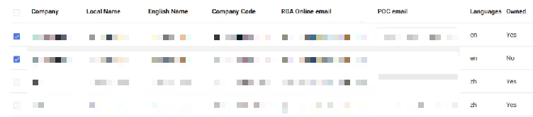

第3步：审核工厂联系人的邮箱（POC）
请审核“RBA在线”电子邮件是否是工厂管理员的电子邮件地址
（POC）
如果这不是工厂的反馈管理器电子邮件地址，请输入正确的电子邮件地址作为POC的电子邮件，确保工厂反馈管理器可收到反馈工具的激活电子邮件。
Notes:
(Step 3)
Review if the RBA Online Email is the correct email address of the Factory’s Feedback Manager
In case this is not the email address of the factory’s feedback manager, please type in the correct email address as the POC Email so that the factory’s feedback manager can receive the feedback tool onboarding email.

Slide 25
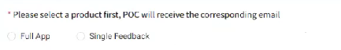
第4步：选择产品类型并确认发送
A、选择产品1-全部应用程序或产品2-单一有问必答工具
完成该步骤后，系统将自动向工厂管理员发送邮件。
（重要：已经向各个工厂部署有问必答工具）
Notes:
(Step 4)
Select Product 1 – Full App or Product 2 – Single Feedback Tool
Then confirm to send.
After completing this step, the system will send out the Onboarding Email to the factories.

Slide 26
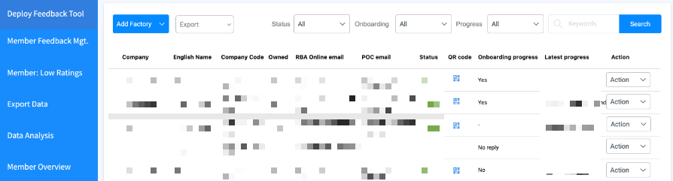
跟踪激活进度
可不时通过重新访问【部署有问必答工具】页面来跟踪FTY的进度
和查看【激活进度】。
条款说明：
同意：工厂同意部署有问必答工具，激活电子邮件已发送至工厂指定的管理员电子邮件。
不同意：工厂拒绝使用有问必答工具
进行中：工厂尚未访问该链接来分配管理员
已过期：工厂尚未访问要分配工厂管理员的链接。发送邀请函电子邮件起已经20天了。因此，该链接已过期。
Notes:
You can track FTY ‘s progress by re-visiting the [Deploy Feedback Tool] page
from time to time & view [Onboarding progress]
Agree: Factory agrees to deploy Feedback tool & the Onboarding Email has been sent to factory’s designated feedback manager’s email.
Disagree: Factory declines to use the Feedback Tool
In Progress: Factory has not accessed the link to assign the feedback manager
Expired: Factory has not accessed the link to assign the feedback manager. And It have been more 20 days since the Invite Email was sent. Therefore, the link has been expired.

Slide 27
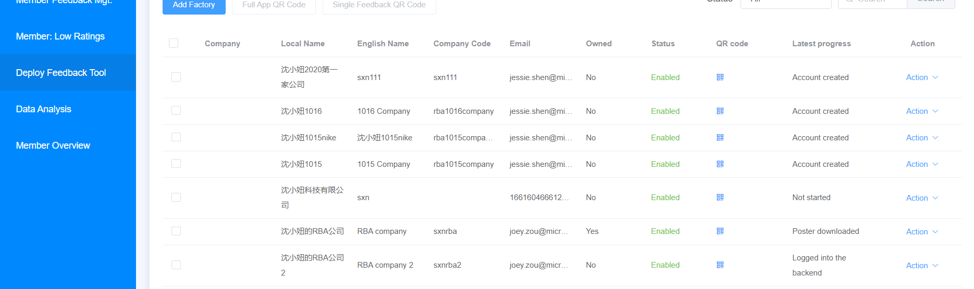
跟踪部署进度
请不时点击【部署有问必答工具】页面，并查看【部署进度】。
条款说明
未启动：会员未向工厂部署二维码
已创建的帐户：激活电子邮件已发送到工厂指定的电子邮件地址。
已下载海报：工厂已收到激活电子邮件，并下载了海报进行打印
登录到后端：工厂已完成阅读激活快速指南，登录到后端，并启动管理工具
Notes:
You can also track Factory‘s progress by re-visiting this same page of [Deploy Feedback Tool] from time to time.
Here at the [Latest progress] column, there’re 4 types of status:
Not started: Member has NOT deploy feedback tool to Factory
Account created: The Onboarding Email has been sent to factory’s designated email address.
Poster downloaded: Factory has received the onboarding email & downloaded the feedback poster for printing
Logged into the backend: Factory has completed reading the onboarding quick guide, logged into the backend & start managing the feedback tool

Slide 28


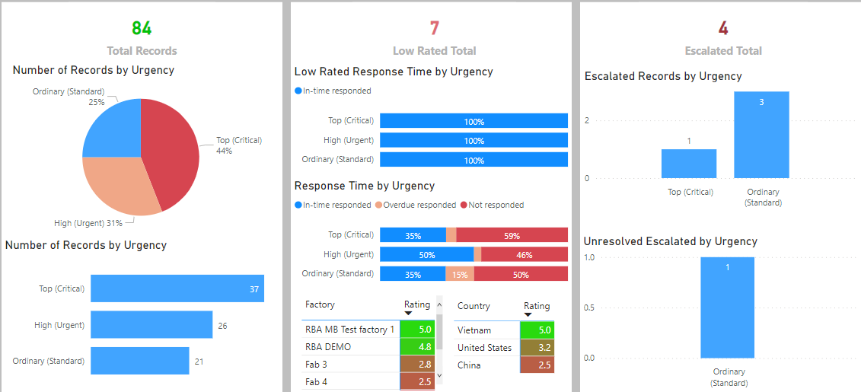
报告
工厂将有问必答工具部署给员工后，
员工扫描海报上的二维码，使用有问必答工具，
后台系统将分析收到的反馈总数，并生成会员分析报告。
工厂将工具部署给员工
员工提交反馈意见
工厂对反馈意见进行回应
系统记录所有反馈对话
会员查看分析记录
Notes:
Once the Factory deploys the Feedback Tool to the Employees
and the Employees scan the QR Code on the Poster to use the Feedback tool, the Backend system will analyze the total number of feedback received and generate the Analysis Report for the Member.

Slide 29
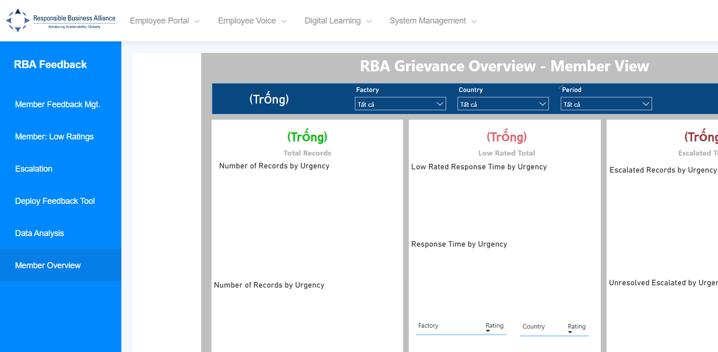
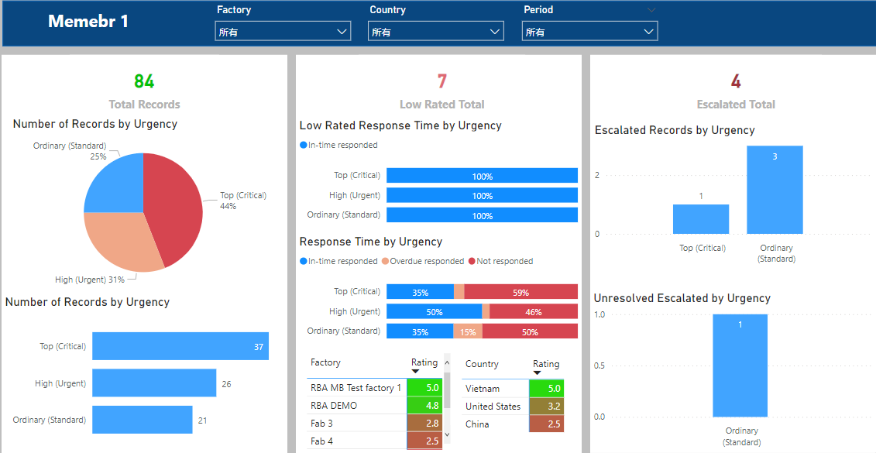
如何查看报告：点击左边面板上的【会员概览］
会员可以在这里查看会员连锁供应工厂的员工所提交的反馈意见总数
Notes:
Here’s how Member can view Report:
Please login to the Member Backend, go to the Feedback Tool management page, on the left panel, click on [Member Overview]
On the left panel, click on [Member Overview].
Here, Member can view the total number of feedbacks submitted by the employees from the Member’s Chain Supply Factories

Slide 30
通过选择工厂名称、国家和时段，选择查看特定的报告。
Notes:
You can choose to view a specific report by selecting Name of factory, Country and Period of time.
This report can be viewed as many times as you want and anytime

Slide 31
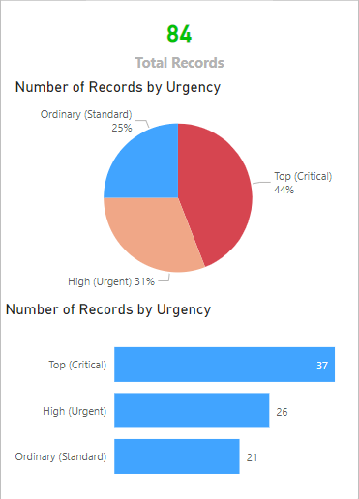
条款 1.1说明
总记录：一段时间内提交的反馈意见总数。
紧急程度是什么？
                普通（标准）：低紧急反馈，需要在72小时内作出回应
                高（紧急）：高紧急反馈，需要在48小时内作出回应
                高（关键）：非常紧急的反馈，需要在24小时内作出回应。
Notes:
If this is the first time you have seen this report, here are some description of terms to help you understand how to read this report. You can pause this video here to take a closer look.

Slide 32
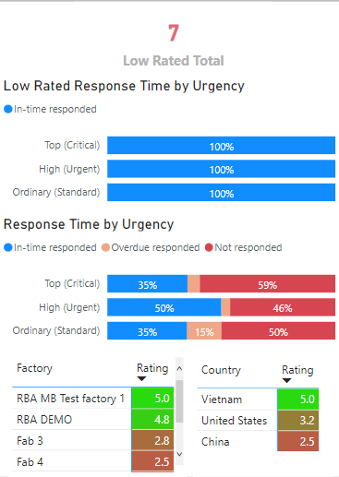
条款 1.2说明
评级：员工可以通过打分表明其对管理员答复的满意程度（评分数据只有在工厂启用评分功能并且用户选择给予评分时才可用）
低总评分：员工满意度评分低于2.5的反馈问题的总数
按紧急程度划分的低评级响应时间：根据响应状态和反馈紧急程度划分的低评级问题
按紧急程度划分的响应时间：所有反馈信息按照回复状态和问题紧急性划分
及时回复：工厂已在回复时限内回复了反馈意见
逾期未回复：工厂已在回复时限外回复了反馈意见
未回复：工厂没有对反馈意见进行回复

Slide 33
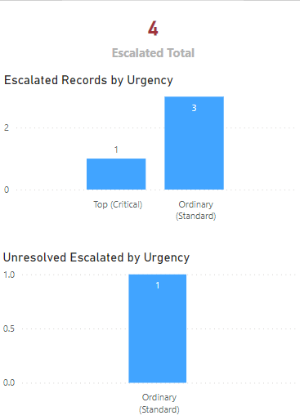
条款 1.3说明
升级总数：升级的反馈意见总数，需要更高级别的管理层关注
按紧急程度的升级记录：根据问题紧急程度划分的升级问题总数
                按紧急程度划分的未解决的升级问题。根据问题紧急程度，对仍未解决的升级问题进行细分。
Notes:
And that is all for this video. Thank you for watching.

