Slide 1
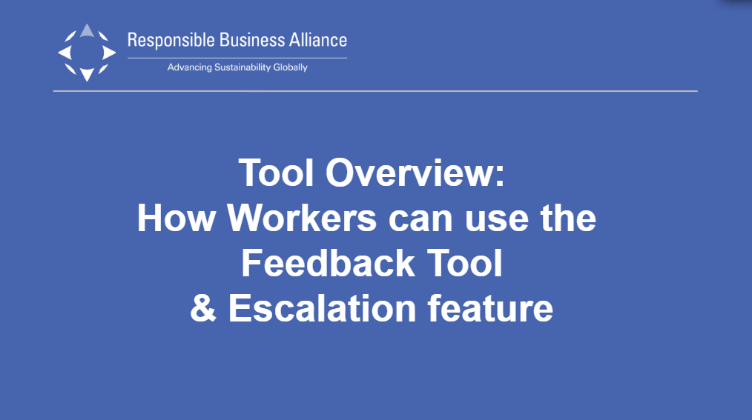
Notes:
After Member has deployed the tool to the factory, the QR Code will be automatically emailed to the factory
Factory will then print out a QR Code poster & position it in common areas such as production floor, canteen, dormitory, rest room, or parking lot.
Workers scan the QR Code & access the tool.

Slide 2

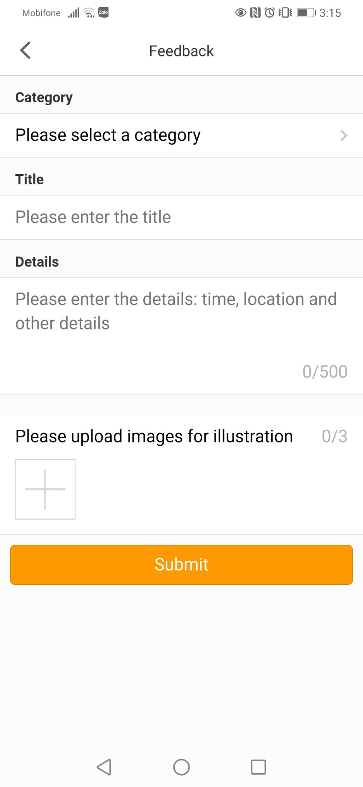
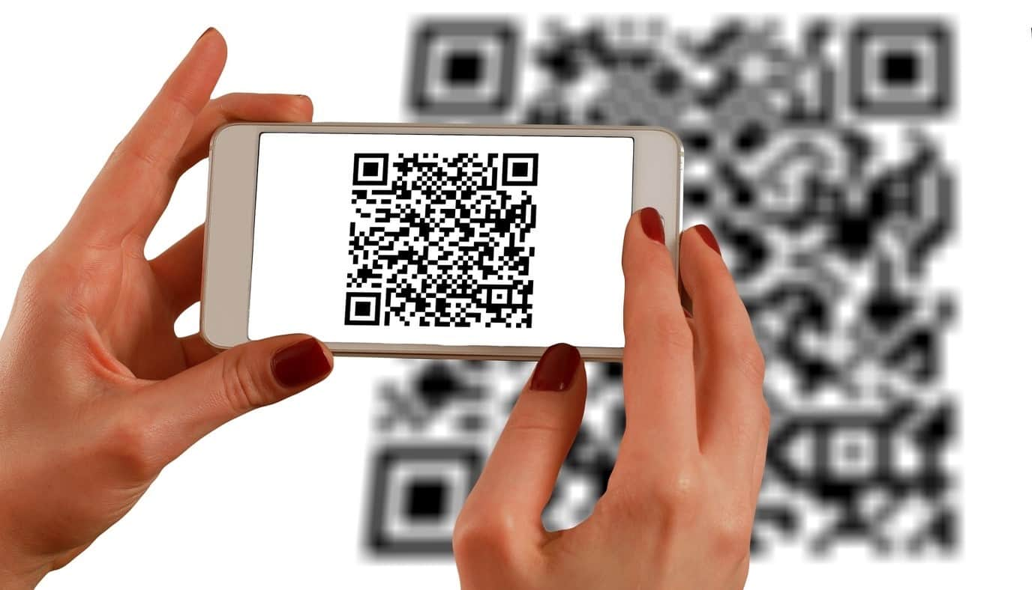
How Workers Can Use the Tool
After Member has deployed the tool to the factory, the QR Code will be automatically emailed to the factory.
Factory will then print out QR Code poster & position it in common areas such as production floor, canteen, dormitory, rest room, or parking lot.
Workers scan the QR Code & access the tool.
Notes:
After Member has deployed the tool to the factory, the QR Code will be automatically emailed to the factory
Factory will then print out a QR Code poster & position it in common areas such as production floor, canteen, dormitory, rest room, or parking lot.
Workers scan the QR Code & access the tool.

Slide 3
There Are 2 Options For Worker to Access the Tool
Depending on Member’s decision to either deploy Product 1 or 2,
the Factory will receive a QR Code with the corresponding product option
Product 1: Full App
Product 2: Single Feedback Tool
After scanning the QR Code, worker will be prompted to install the RBA Voices App which includes multiple features:
Feedback Tool
Survey Tool
Worker Learning Academy
After scanning the QR Code, worker will directly go to a web browser which only includes:
Feedback Tool
Notes:
There Are 2 Options For Worker to Access the Tool
Depending on Member’s decision to either deploy Product 1 or 2, the Factory will then receive the QR Code with the corresponding product option

Slide 4
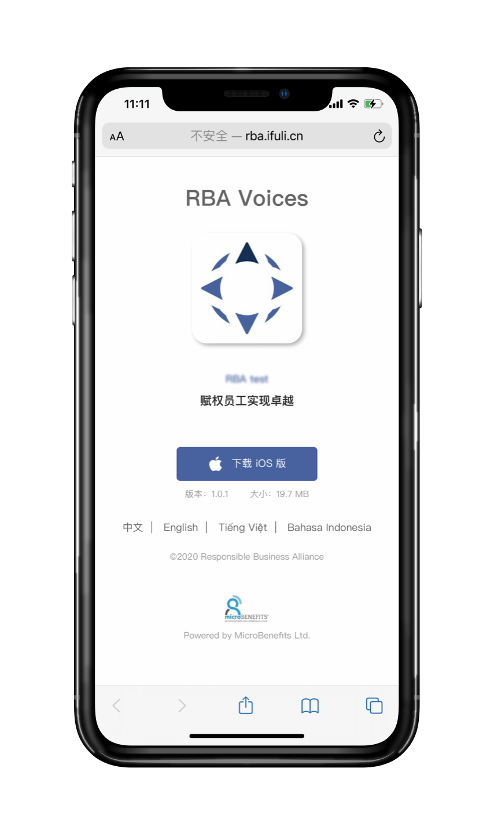
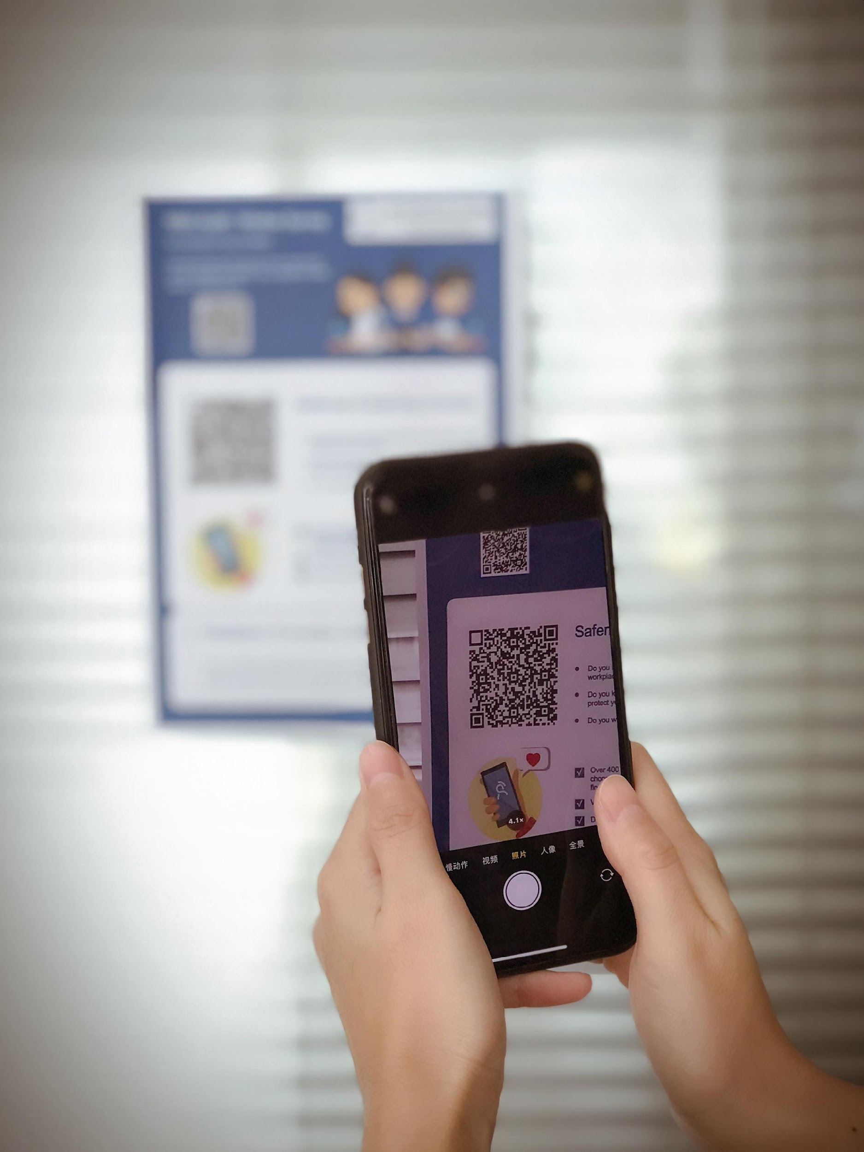
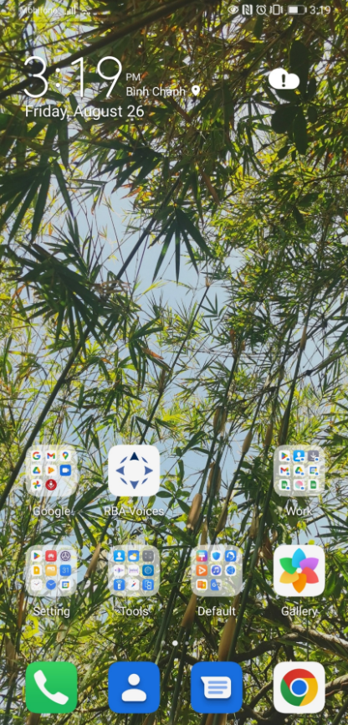

Product Option 1: Full App
After scanning the QR Code, you will be prompted to install the RBA Voices app.
Step 1: Install the RBA Voices App & Sign up for a new account.
Available on both IOS & Android
Notes:
Product 1: Full App
After scanning the QR Code, you will be prompted to install the RBA Voices app. This app will includes multiple features such as:
-Feedback Tool
-Survey Tool
-Worker Learning Academy
(Step 1)
Click download & install the app.

Slide 5
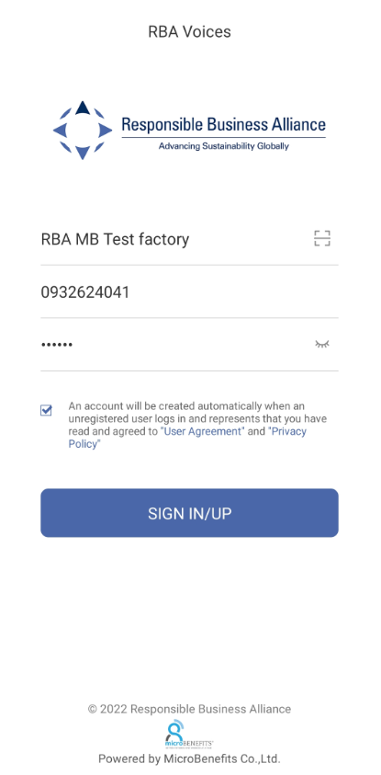

Step 2. Open the App & Sign up.
Your Username should be your Employee ID or Mobile Number.
For the first time login, you can set the password according to your own choice.
Please check if the Factory Name is correct. This will ensure that your feedback will be responded to by your factory manager.
Factory name
Employee ID or Mobile #
Employee’s Choice of Password
Once you have completed sign up,
please remember your choice of password for future login.
Notes:
(Step 2)
Open the App & Sign up.
Your Username should be your Employee ID or Mobile Number
For the first time login, you can set the password according to your own choice.
Once you have completed sign up, please remember your choice of password for future login

Slide 6
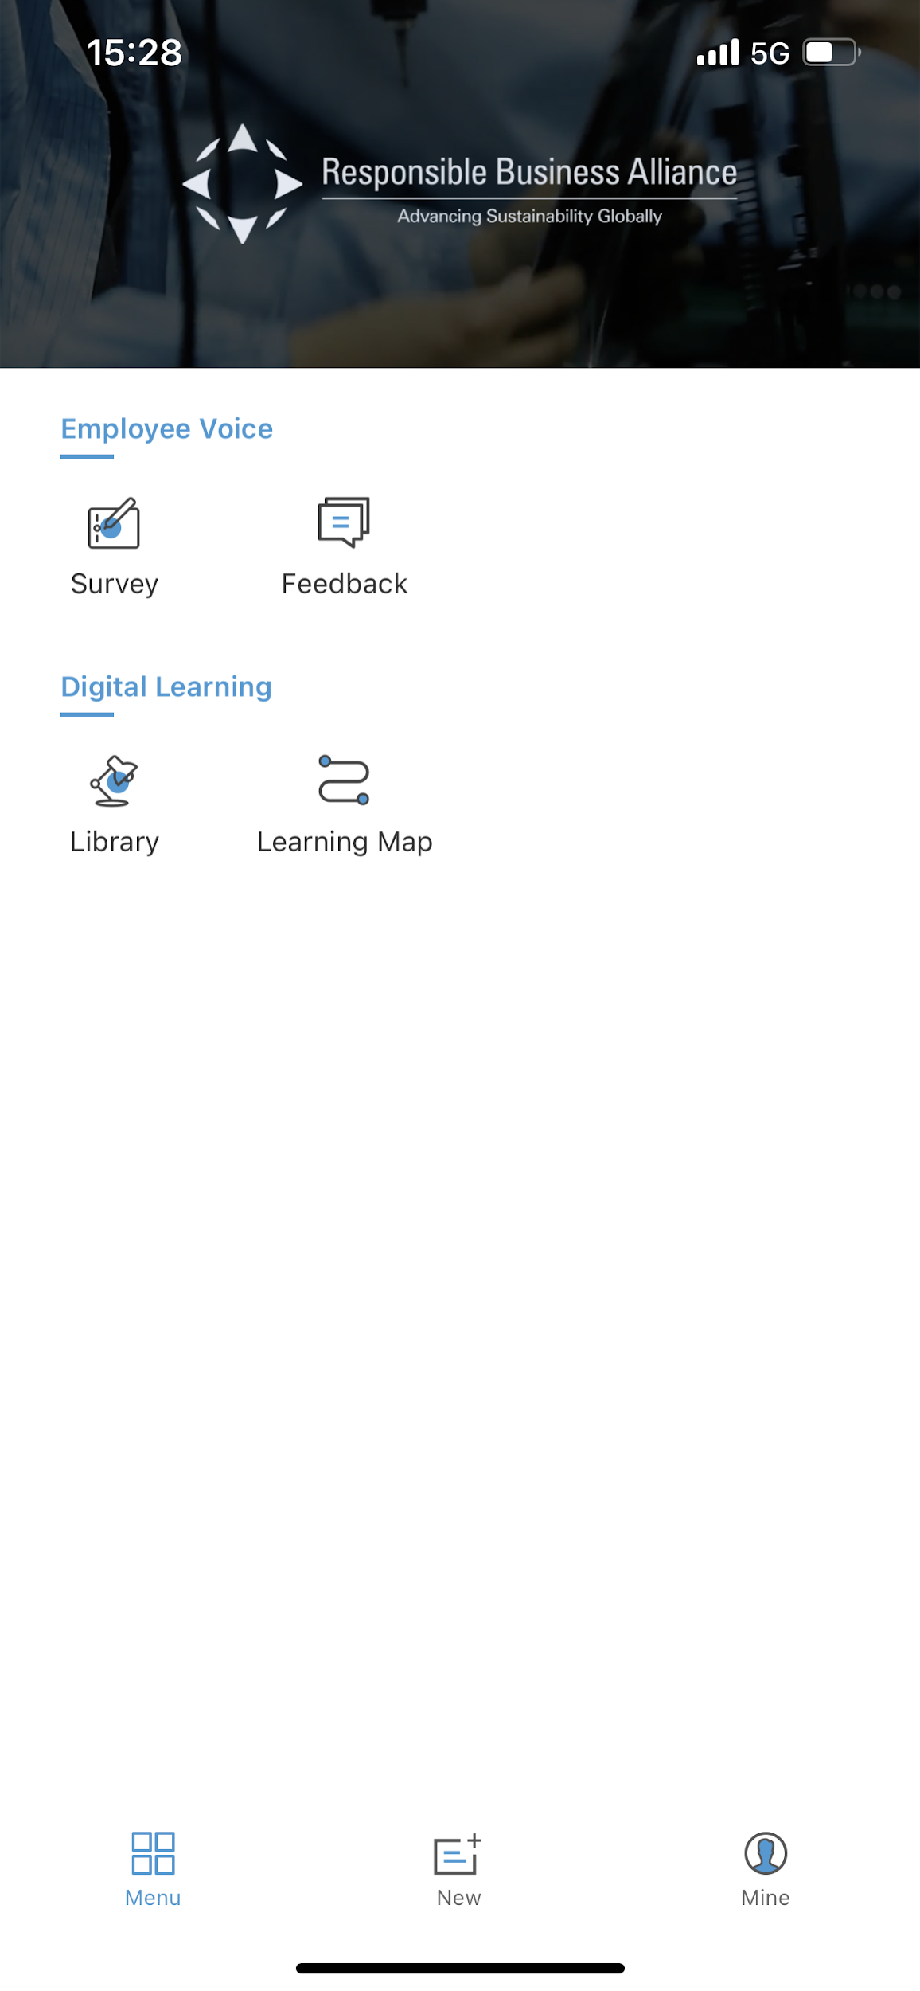
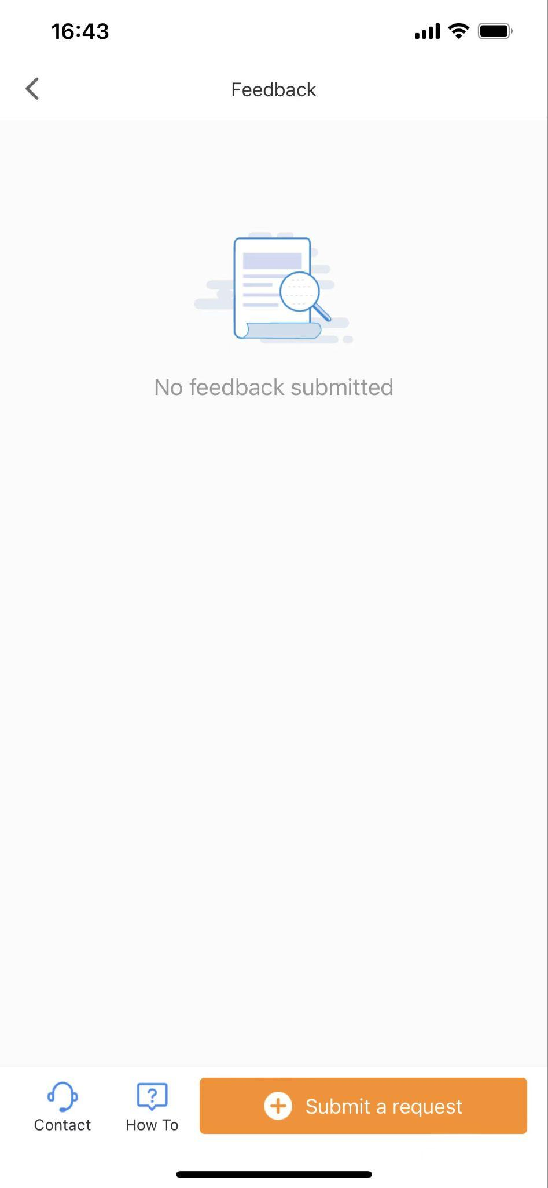
Step 3. Select [Feedback] Tool -> Click on [Submit a request] -> Click on [Select a category]
Notes:
(Step 3)
Select [Feedback] Tool
Click on [Submit a request]
Click on [Select a category]

Slide 7
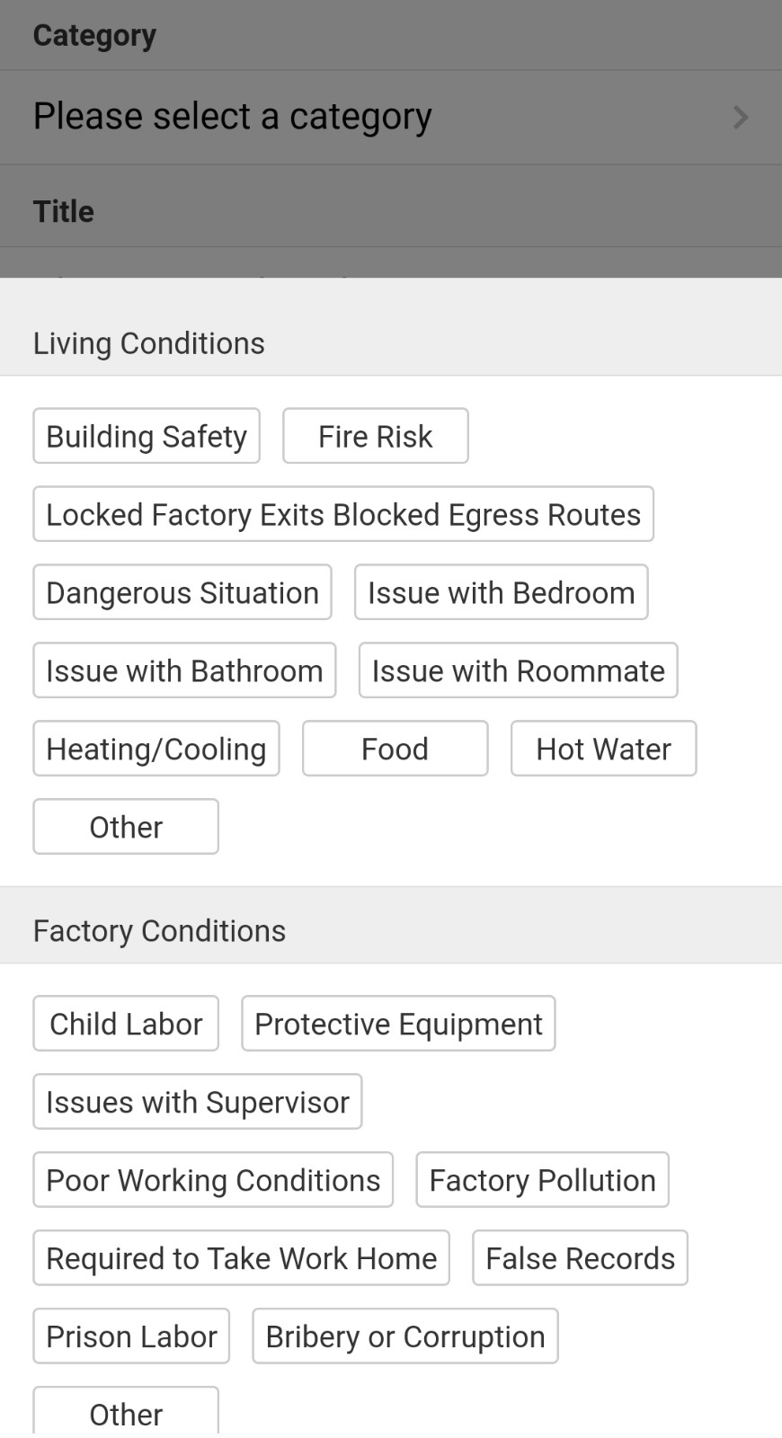
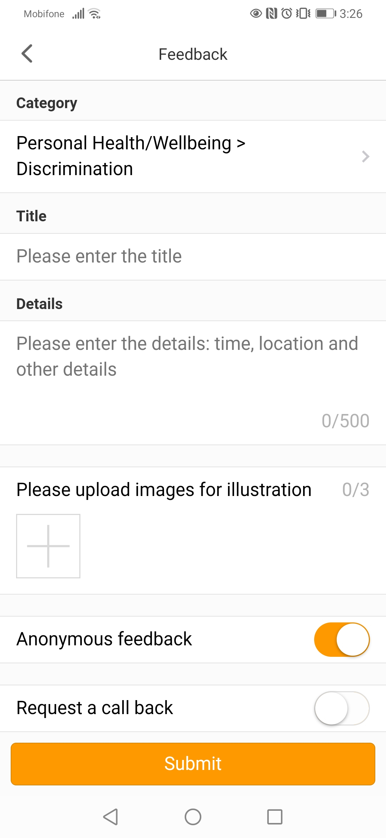
Step 4. Select the topic that is relevant to your Feedback -> Enter Feedback content -> [Submit]
Worker types in their support request / inquiry / complaint / suggestion
Insert photos from phone for evidence (optional)
Choose to send Feedback anonymously (optional)
Leave phone number & request factory to call back (optional)
Notes:
(step 4)
Select the topic that is relevant to your Feedback
Enter your feedback content
(insert an demo inquiry)
Click on [Submit] to send the feedback

Slide 8
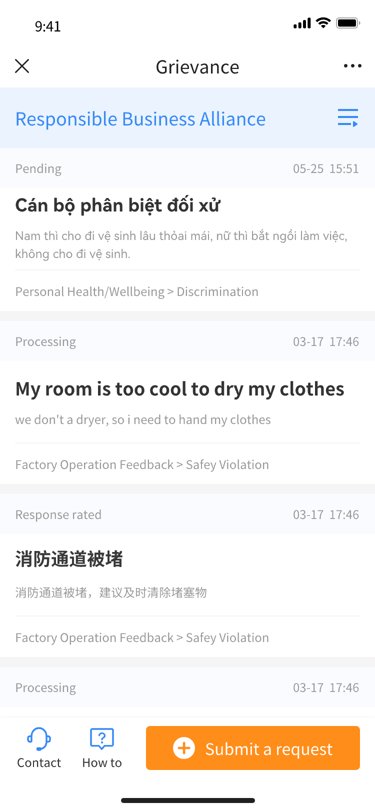
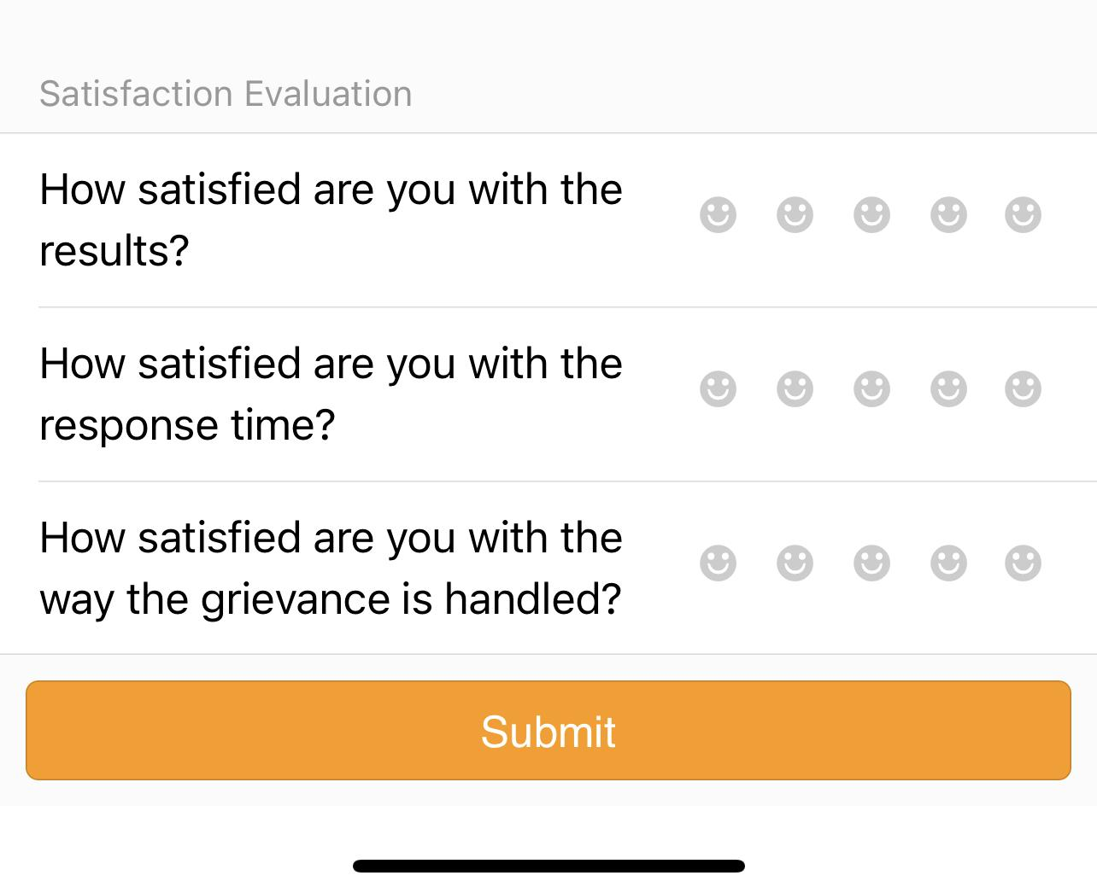
Step 5. Login periodically to check for a response from the factory.
Once the communication is closed by the factory,
the worker will have the ability to rate their experience.
Notes:
(step 5)
Login periodically to check for a response from the factory.
Once the communication is closed by the factory, the worker will have the ability to rate the experience.

Slide 9
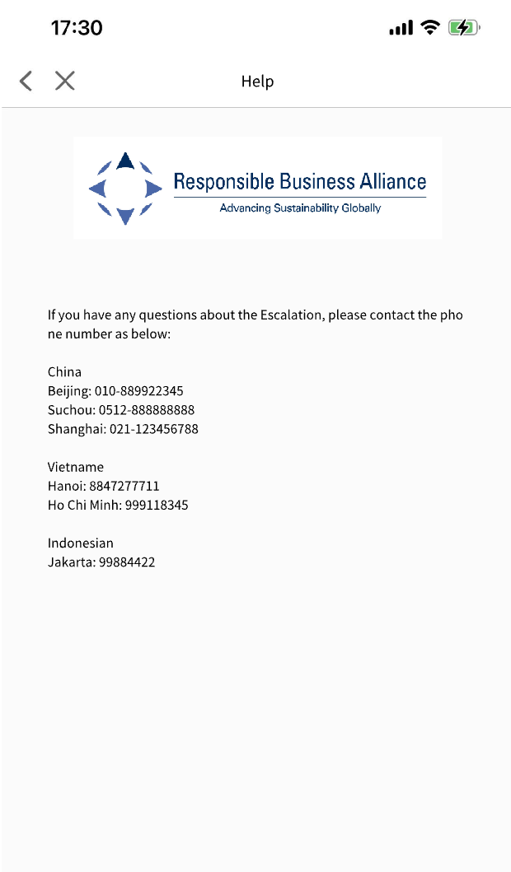


In case you do NOT know how to submit Feedback,
Click on [How To] to view the step-by-step instruction video or reach the [Contact] hotline
Multi-Languages Contact List
Step-by Step Instruction Video
Notes:
In case you do NOT know how to submit Feedback, please click on [How To] to view the step-by-step instruction video or reach the [Contact] hotline

Slide 10
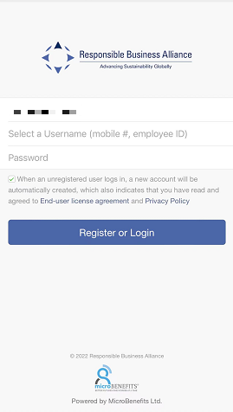
Product Option 2: Single Feedback Tool (optional)
After scanning the QR Code, you will be directed to a web browser.
Step 1. Enter your Employee ID or Mobile Number for Username.
Then, enter your choice of Password.
Please remember your choice of password for future login.
Notes:
Product 2: Single Feedback Tool
After scanning the QR Code, you will directly go to a web browser, which only includes the Feedback Tool
(Step 1)
Enter your Employee ID or Mobile Number for Username
Then, enter your choice of Password
Click [Register or Login]

Slide 11
Step 2. Click on [Submit a request] > Select a category > Enter the feedback content
Notes:
(Step 2)
Click on [Submit a request]
Select a category
Enter the feedback content

Slide 12
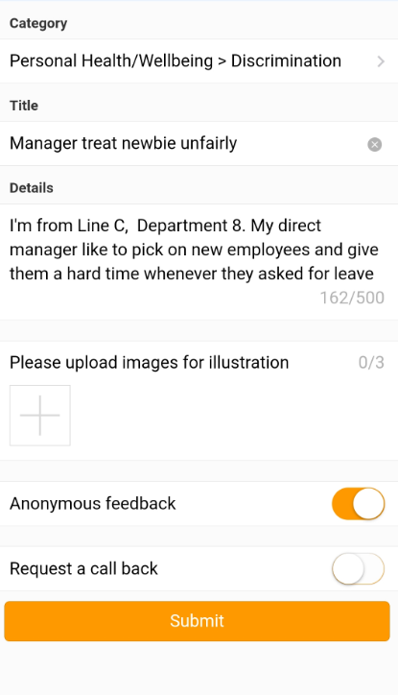
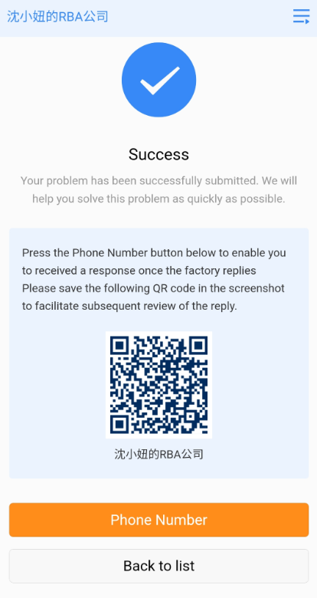
Step 3. Click [Submit] > Click on the Phone Number & enter your cellphone number (optional)
screenshot and save the QR Code.
You can scan the QR Code periodically to check for a response from the factory.
If you entered your phone number on this page, please wait for the system to send you an SMS notification when the factory responds to your feedback.
Notes:
(Step 3)
Click [Submit]
Click on the [Phone Number] button & enter your phone number. Then please save the screenshot of this QR Code.
The system will send you an SMS notification whenever the factory responds
To check for a response from the factory, please scan this QR Code from your screenshot.

Slide 13
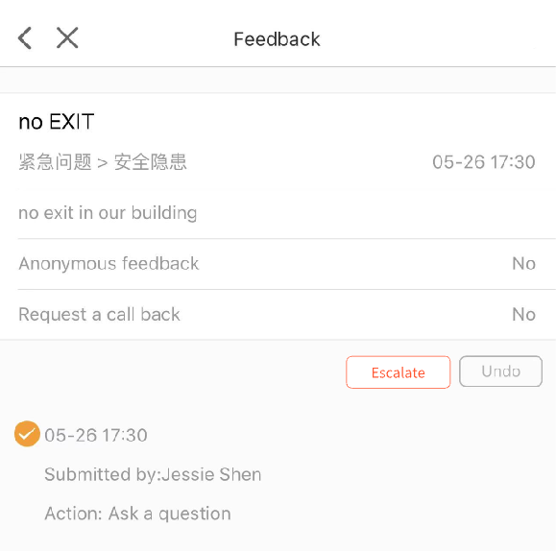
Escalation feature
After submitting a feedback, if you feel your inquiry has not received the appropriate attention, or wasn’t not solved.
Each worker has the right to "Escalate" their feedback of certain category to a 3rd party professional.
The Escalate button sends the worker feedback to a 3rd party professional to review and “possibly” take additional action.
You can find the "Escalation" button on the feedback detail page. The escalate button will not show until after 48 hours, or once the inquiry has been closed by the factory administrator. Whichever occurs first.
Each inquiry will be kept completely confidential, anonymous, private and answered by a specific 3rd professional.
For your benefit and confidentiality. Once an inquiry has been escalated, the factory management does not have access, nor can they see or view any communication between you or the 3rd party. This feature ensures that you have a great experience, with a strong voice.
Submit Escalation

