Slide 1
如何将工具部署给工人
Notes:
Welcome to Factory Quick Guide Video
In this video, we will teach you How To Deploy the Feedback Tool To Your Workers

Slide 2
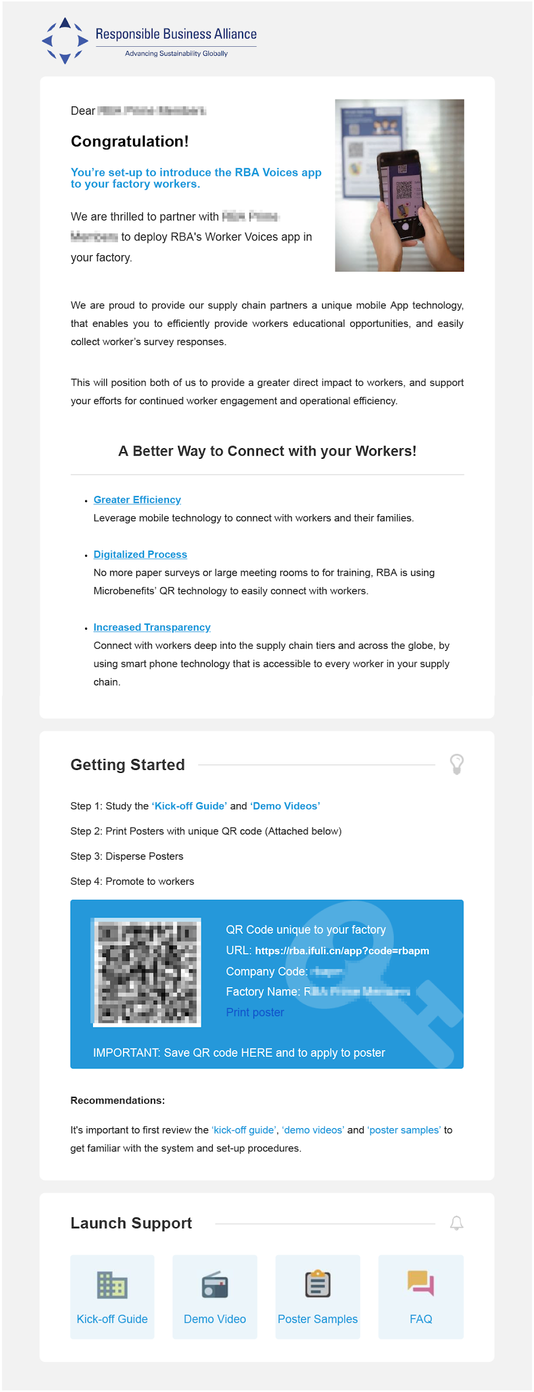
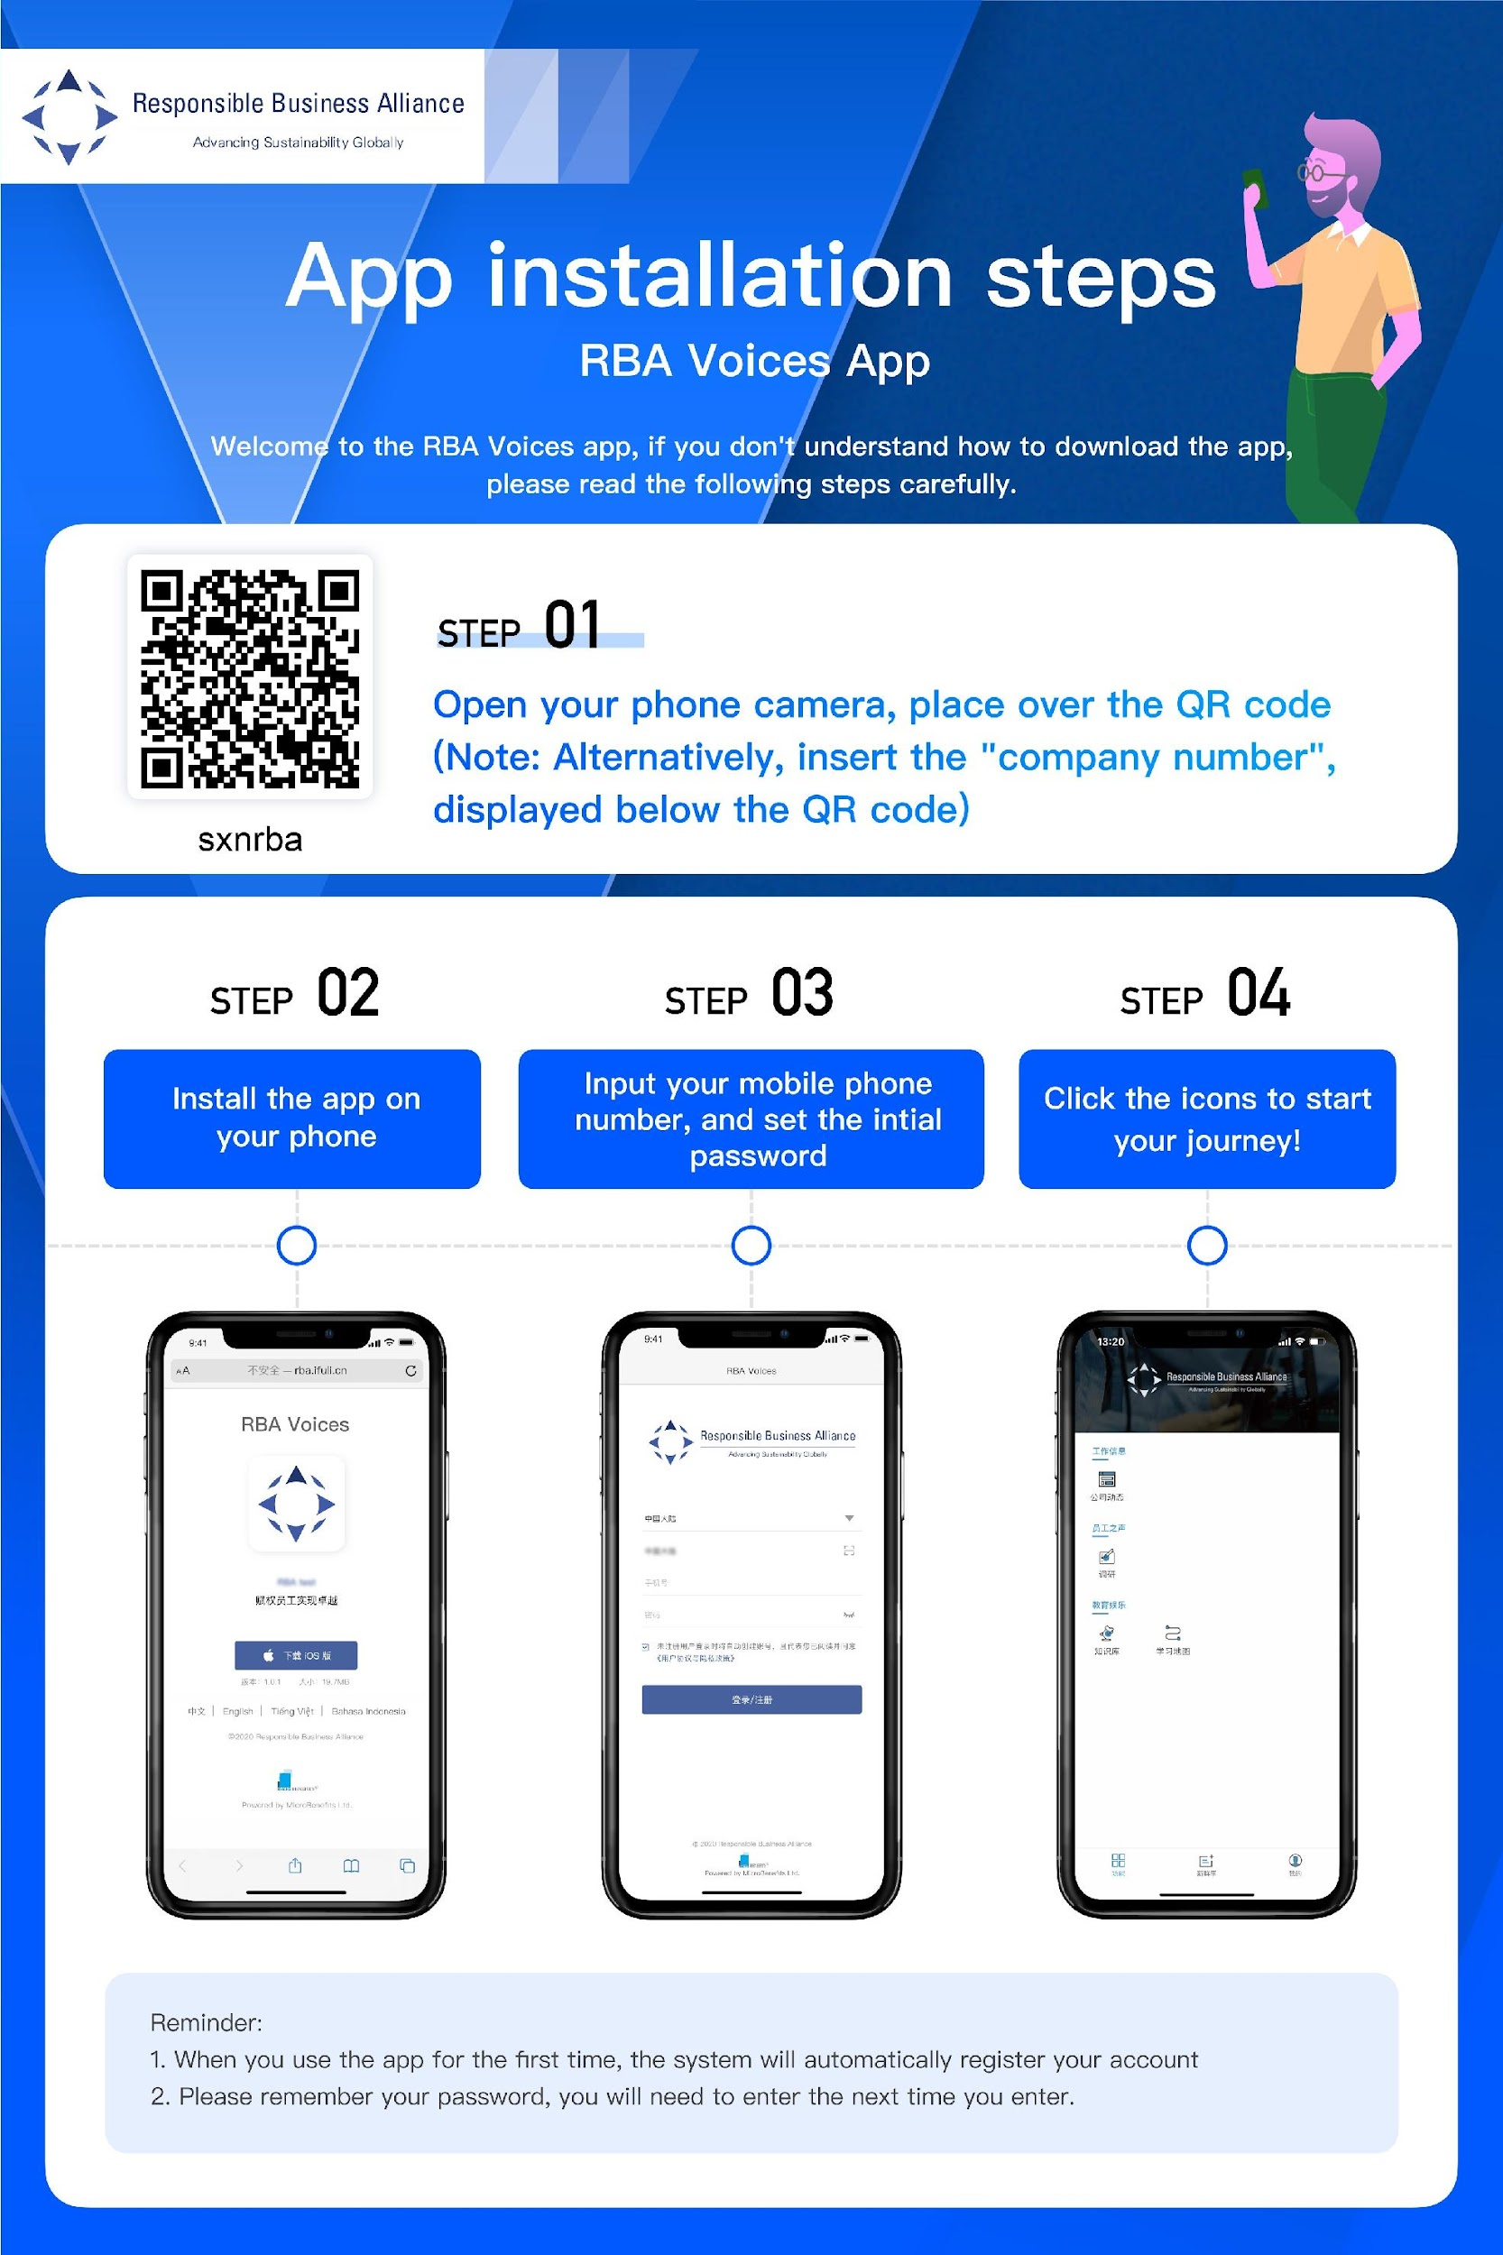

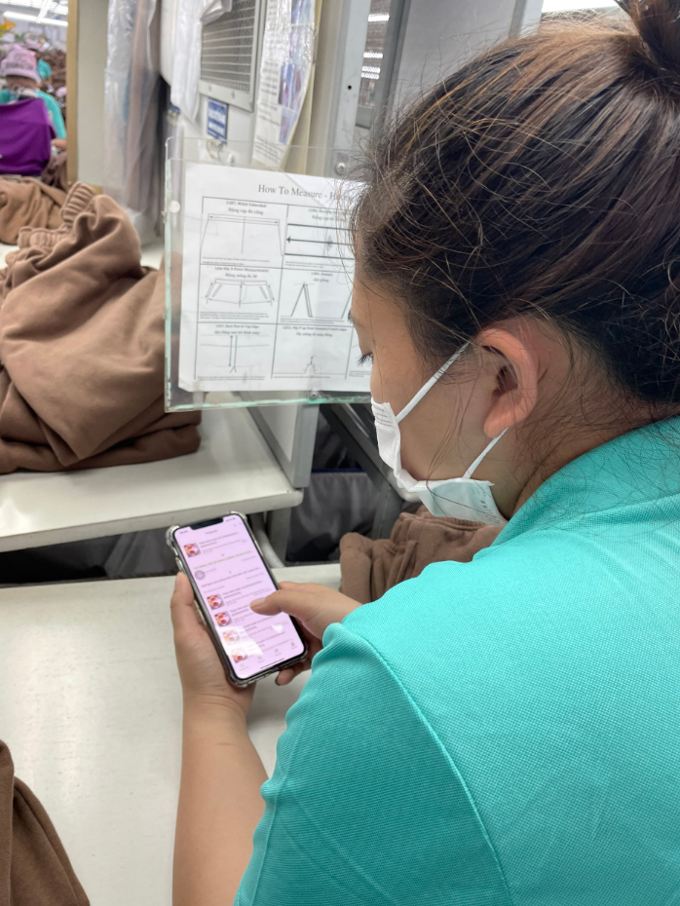


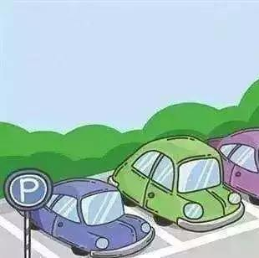


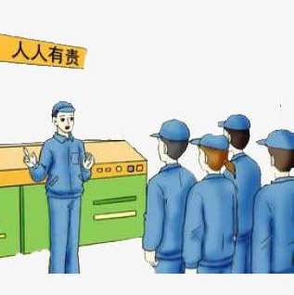
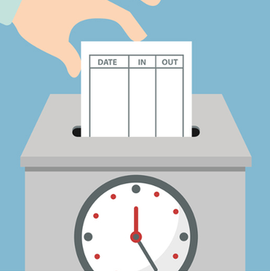
工具部署过程
工厂收到
登录邮件
工厂打印二维码
工厂在公共区域张贴二维码
工厂向工人宣传工具
工人通过扫描二维码获取工具并提交反馈意见
宿舍
食堂
停车场
休息室
生产部
各楼层
打卡区
Notes:
First, let’s take a look at the overall Tool Deployment Process
By now you have already received the Onboarding Email
In this video, we will guide you through the key contents which are included in that email
Next, We will also teach you how to print out the Feedback Tool Promotion Poster, where to position it within your factory
And what are the most efficient practices to promote the tools to your worker
Lastly, the final goal in this process is successfully invite workers to scan the QR Code on the Poster, access the Tool and Submit feedback whenever they have any inquiries.
It’s a simple process, but it will require the initiative of factory management in order to invite & win the trust of workers, get them to be willing to communicate with the factory. By the end of this deployment process, we hope that your workers will feel encouraged to raise questions, voice up grievance, give innovated suggestions or comments through the Feedback Tool to contribute for the constant improvement of your company.

Slide 3
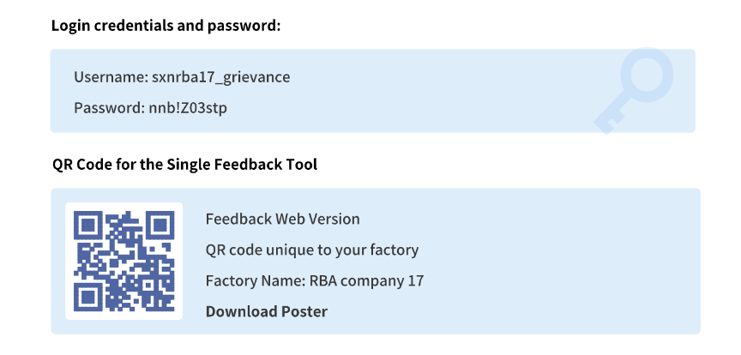

第1步收到登录邮件
工厂联络员（POC）将收到一封登录邮件，内容包括：
工厂后台登录账号
供工人扫描和获取工具的二维码
工厂打印的预制二维码
Notes:
Let’s start with step 1. Receive Onboarding Email.
The Onboarding Email that has been sent to your Factory POC will include:
Factory’s Backend Login Credentials
QR Code for workers to scan & access the tool
Pre-made Poster for Factory to print out

Slide 4
第2步。下载二维码
点击登录邮件中的【下载二维码】。
下载二维码
Notes:
Step 2. Click on the [Download Poster] button in the Onboarding Email & download the Poster design

Slide 5
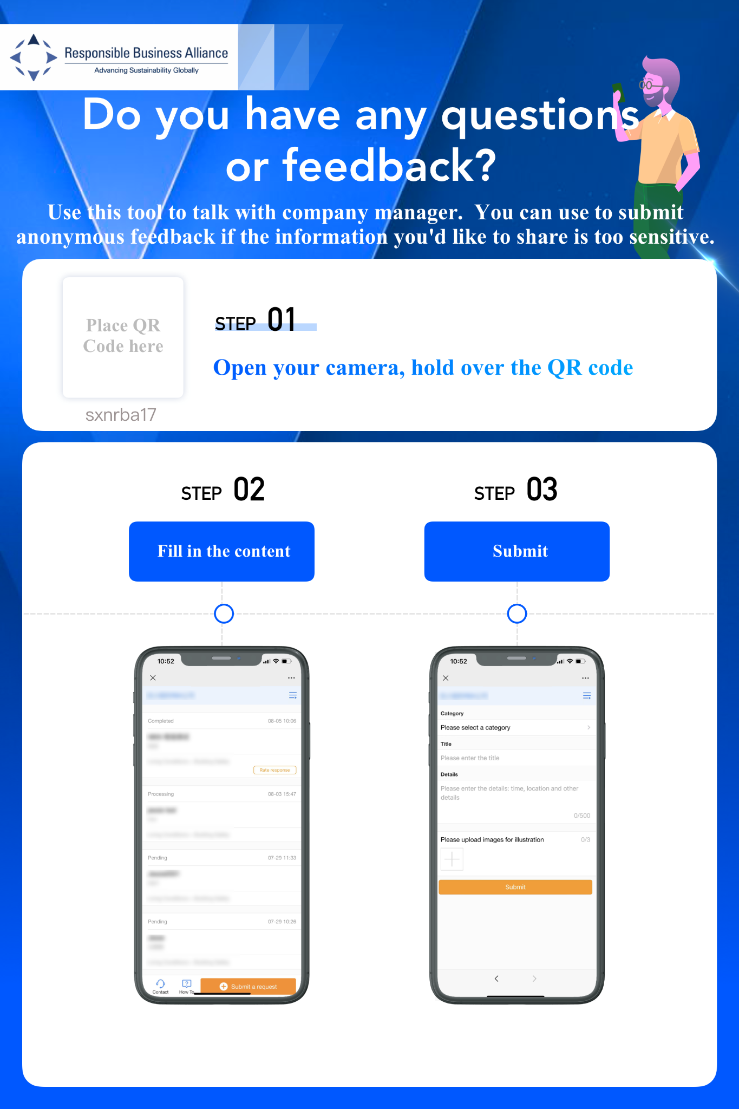
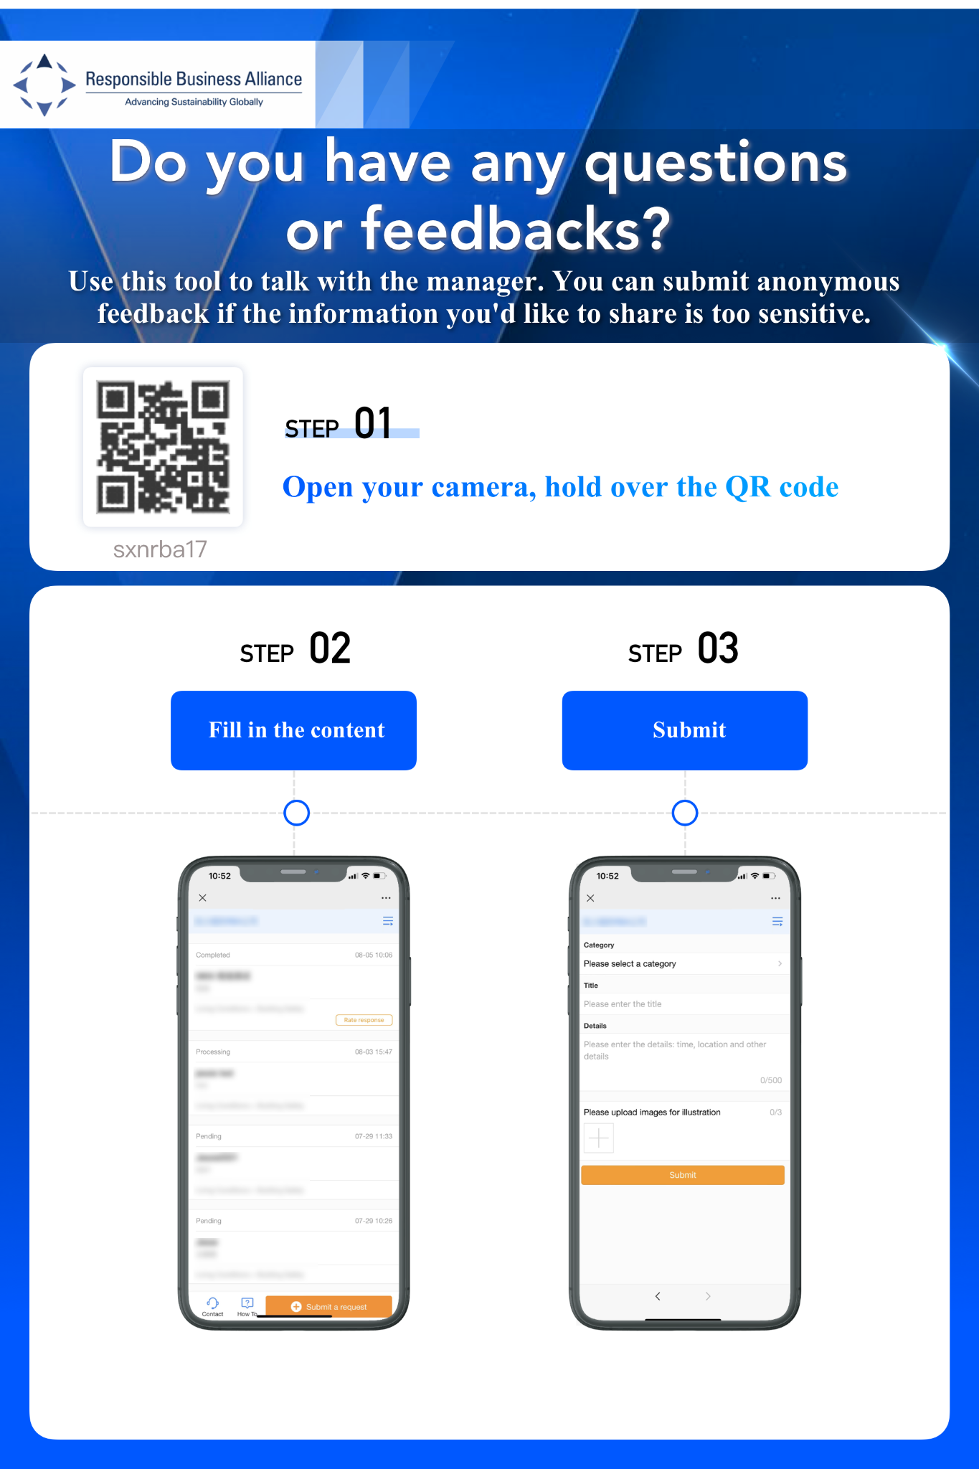
第3步。打印出二维码
打印多份二维码。
Notes:
Step 3. Please print out multiple copies of the Feedback Tool Promotion Poster.
In that poster, there should be: (1) a QR Code which provides a unique access for your factory, (2) an invitation for workers to use this Tool if they want to raise their voices; and (3)
Instructions on how to submit feedback after scanning the QR Code
This poster will help the workers to easily understand how to use this tool & feel more confident in submitting feedback by themselves without asking for assistance from someone, especially if they wish to remain anonymous.

Slide 6



第4步。在公共区域张贴二维码
在工人熟悉的地方张贴二维码
方便工人扫描
二维码，并根据个人需要提交反馈意见
宿舍
食堂
停车场
在工厂内人流量大的地方张贴二维码，方便工人很容易地接触到该工具。当工人在有任何疑问时，更有可能提交在线反馈。
休息室
盥洗室
打卡区
生产车间
打印区
Notes:
Next, for step 4. Please position these promotion posters in common or high-traffic areas within your factory.
Such as Dormitory, Canteen, Parking Lot, Lounge Room, Rest Room, Clock-In Area, Production Floor, and Printing Area
Having posters around these strategic areas where workers congregate will help the tool to be more accessible for workers to quickly submit feedback in case of need. It will also allow the factory to connect in a timely way with workers for insights & risk-identifications

Slide 7
第5步。 向工人推广工具
持续2周的自上而下、高覆盖率的宣传推广有助于帮助工人养成使用反馈工具的习惯。
反馈工具帮助工厂从中获得更高价值。
与高级管理层沟通以获得支持
高级管理层向全厂发送电子邮件
组长会议
主管、组长召开5分钟晨会，向工人宣传
张贴二维码
在推广期间，每天都有发言人宣布，此后每周至少重复一次
午休时间，在食堂举行有趣的抽奖活动。例如：安装RBA Voices应用程序，有机会参加幸运抽奖。
自上而下的支持
主管/组长沟通
宣传材料
奖励措施
(可选)
01
02
03
04
Notes:
Next, step 5. Please create a marketing plan to promote the tool to your workers.
We highly suggest for a factory to create a 2-week top-down, high coverage promotion plan, to help workers develop the habit of using the Feedback Tool, which in turn will help the factory achieve greater value from the Tool
You can incorporate these strategies into your promotion plan:
Top Down Support: This will require you to communicate with your senior management to get more support from other departments or senior management can send emails to the whole factory announcing the new available communication feedback tool at the factory. This will make sure the news about Tool Launching will be spread to all factory units
During the promotion period, Supervisor or Team Leader could also help by communicating with their team members: This can be done by each team leader during the usual morning meetings by dedicating 5-minutes each time to guide the worker on how to use the Tool.
Besides having posters as promotion material, the factory can also give short public announcement every day during the promotion period to raise worker’s awareness & curiosity about the Tool. The factory make a record of this announcement and we suggest that after the promotion week, play repeatedly this audio message at least once a week.
Last but not least, factory can also give out incentives as an encouragement to workers who have installed the RBA Voices App. This is optional, depending on the resources of the factory. From our experience, workers will likely adapt & use the new tool quicker if they already have it pre-installed on their mobile phone.

Slide 8
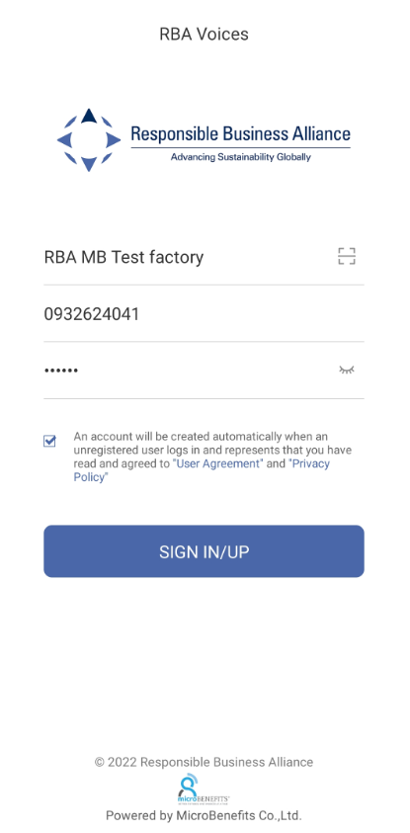
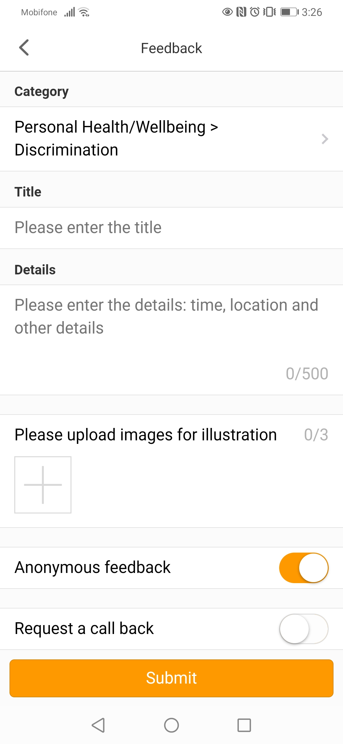
工具推广关键点
1.工具介绍
2.如何获取工具
3.如何注册和登录
4.如何提交反馈和接收回复
-反馈工具：一个移动平台沟通渠道，方便工人与经理进行一对一私人对话。
- 工人可以通过提交反馈意见来帮助工厂确定生产现场风险并改善工作体验。
-工人可以随时、随地方便地查询。
-工人可以匿名查询敏感信息。
-工人可以将投诉升级到第三方机构，以便进一步监督。
工厂名称
员工号或手机号
密码
Notes:
As you communicate with the workers about the tool, here’re 4 key points that you should include:
Point No 1: Tool Introduction
-Feedback Tool: A mobile platform communication channel which allows worker to have 1-on-1 private dialogue with the manager
-Workers can help factory to identify risk at production floor & improve working experience by submitting feedback
-Workers can conveniently submit inquiries from anywhere, anytime
-Workers can submit inquiries anonymously for sensitive information
-Workers can escalate grievances to 3rd party organizations for further oversight.
Point No 2: How to Access the Tool. This instruction can be found directly on the poster.
Point No. 3: How to Sign up/ Log in. It would be best if group & team leader can provide hands-on assistance to the worker on how to type in EmployeeID or Mobile Number & Password
Point No. 4: How to submit Feedback & receive response. Also, Please don’t forget to tell workers about the anonymous feature & escalation feature of the Tool.
It’s very important that during the promotion period, all workers should be aware of these 4 key points.
And that is all for this video. We wish you a very successful deployment.
Thank you for watching

