Slide 1
如何回复工人
Notes:
Welcome to Feedback Tool Quick Guide video

Slide 2
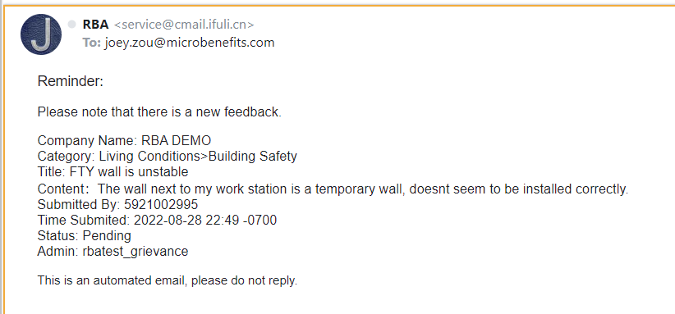
工厂电子邮件通知
当员工提交反馈时，系统会向工厂联络员发送电子邮件通知。
Notes:
When the employee submits a new feedback, the system will send a notification email to factory Point of Contact
After that, the Factory Point of Contact, also known as the Factory Admin will have the responsibility to Login Backend to view the feedback & respond to the feedback within certain time limit.
In this video, we will teach you How to Response to Workers

Slide 3
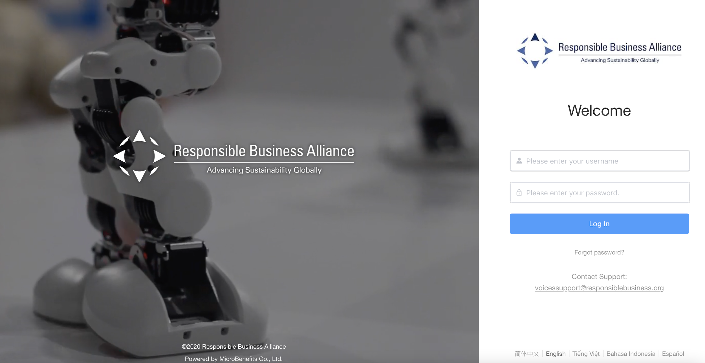
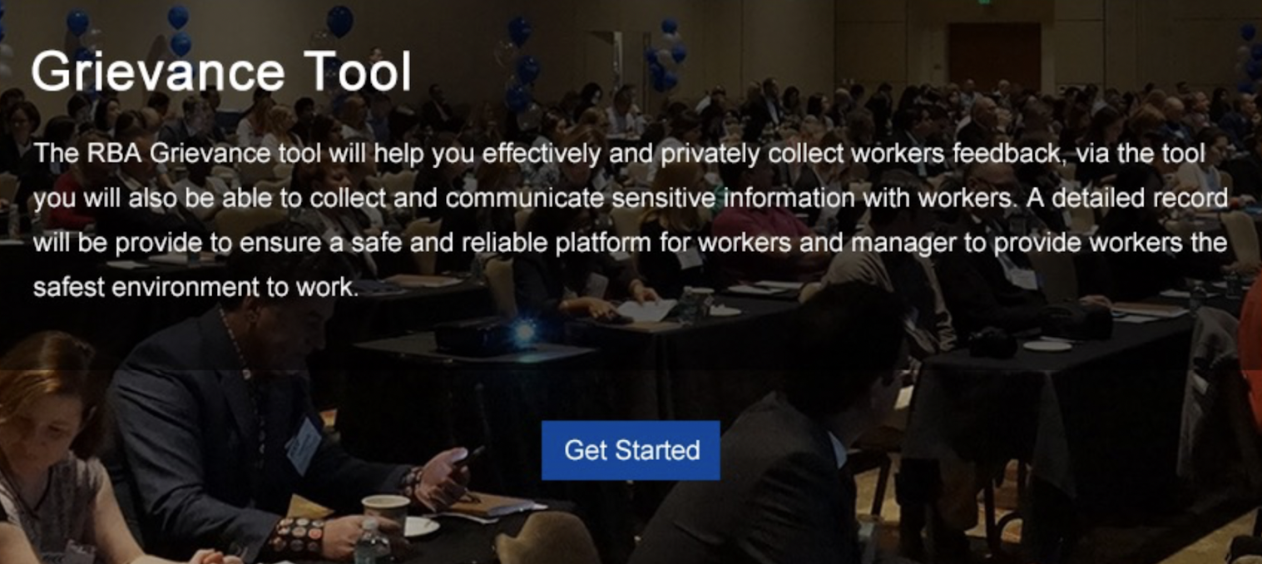
第1步。登录到反馈后台
使用您的登录账号登录后台
在【反馈】工具>点击【开始】。
Notes:
(step 1)
Use your Login Credentials to log-in the Backend
At [Feedback] Tool > Click [Get Started]

Slide 4
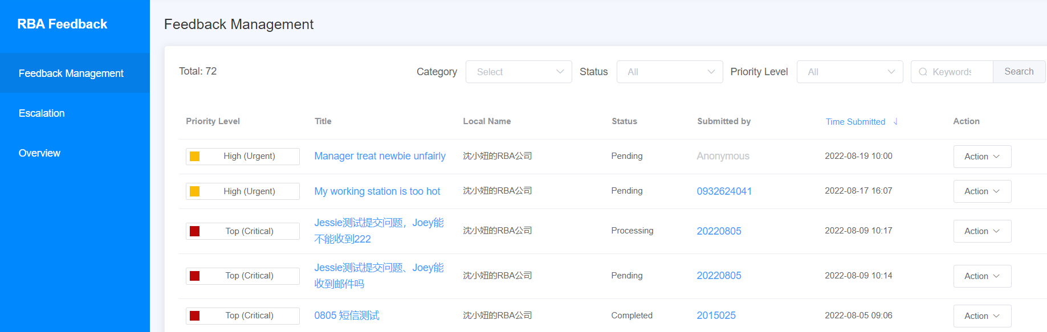

第2步。查看反馈列表
如果员工没有提交任何反馈，
此页面为空。
Notes:
(step 2)
On the Feedback Management page, you can view the list of all feedback submitted by your workers.
(If employees have NOT submitted any feedback, this page will be empty)

Slide 5
反馈类别的3个优先级别
Notes:
According to the Worker Feedback Project Guideline, there are 3 Priority Levels of feedback category.
Depending on the category of feedback submitted by the workers, the feedback will have different recommended timeframe for factory admin to response.

Slide 6
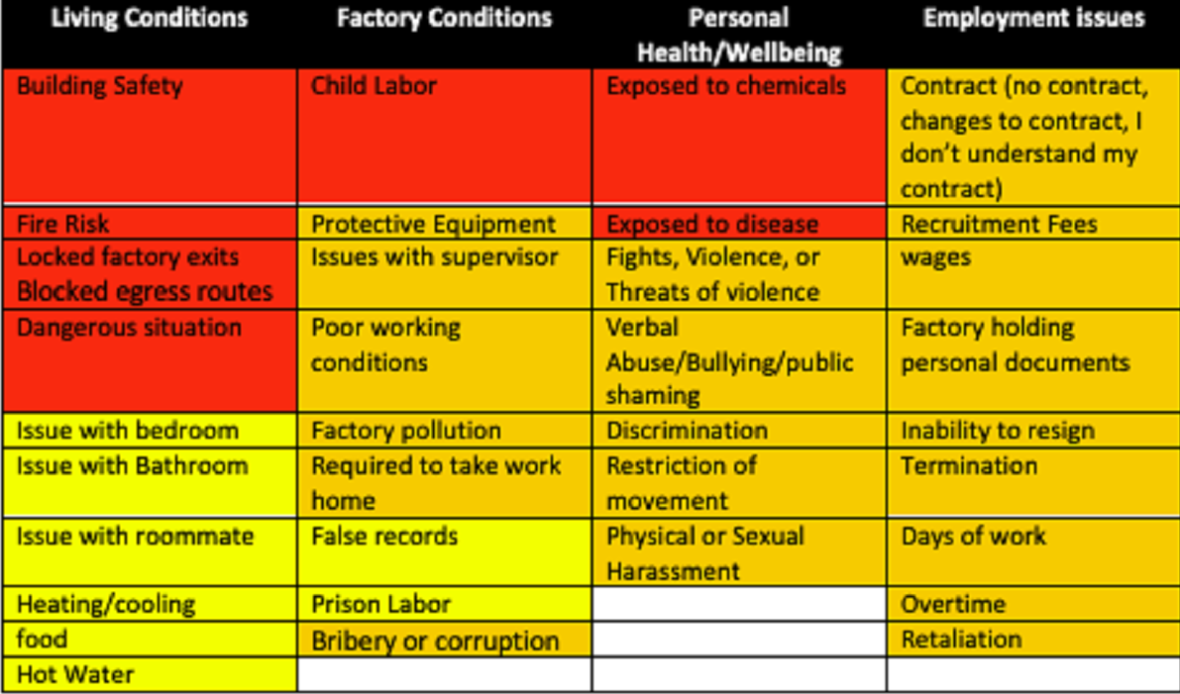
反馈的3个优先级别
                普通（标准）：低紧急反馈类别，需要在72小时内作出回应。
                高（紧急）：高紧急反馈类别，需要在48小时内作出回应
                高（关键）：非常紧急的反馈类别，需要在24小时内作出回应
反馈优先级别
Notes:
Ordinary (Standard): Low urgency feedback category that require a 72 hrs response, mark in red color
High (Urgent): High urgency feedback category that require a 48 hrs response, mark in orange color
Top (Critical): Very high urgency feedback category that require a 24 hrs response, mark in yellow color

Slide 7
5种反馈状态
                待定：工厂尚未对该反馈作出回应
                处理中：工厂尚未关闭该反馈
                已完成：工厂已关闭该反馈
                撤销：员工已经提交了反馈意见，但改变了主意并撤回了该反馈意见
                响应评级：工厂已关闭该反馈，员工对该反馈给出了满意评分。
Notes:
Next, let’s look at the 5 type of feedback status
Pending: Factory has not responded to this feedback yet
Processing: Factory has not closed this feedback yet
Completed: Factory has closed this feedback
Revoked: Employee submitted this feedback but changed his mind & recalled the feedback
Response rated: Factory has closed this feedback & employee have given satisfaction rating score for the feedback

Slide 8
谁提交的反馈？
提交者：提交反馈的员工号或手机号
                匿名：员工在提交反馈时选择了匿名设置
Notes:
Next, on this page, you can also view the employeeID or the Mobile Number of the employee who submitted the feedback & the time they submitted
‘Anonymous’ means that this employee chose the anonymous setting when submitting the feedback

Slide 9
反馈管理
管理员可以通过【类别】、【状态】、【优先级别】或【关键词】搜索特定反馈信息。
Notes:
The factory admin can also search for a specific feedback by [Category],[Status],[Priority Level] or by [Keywords]

Slide 10
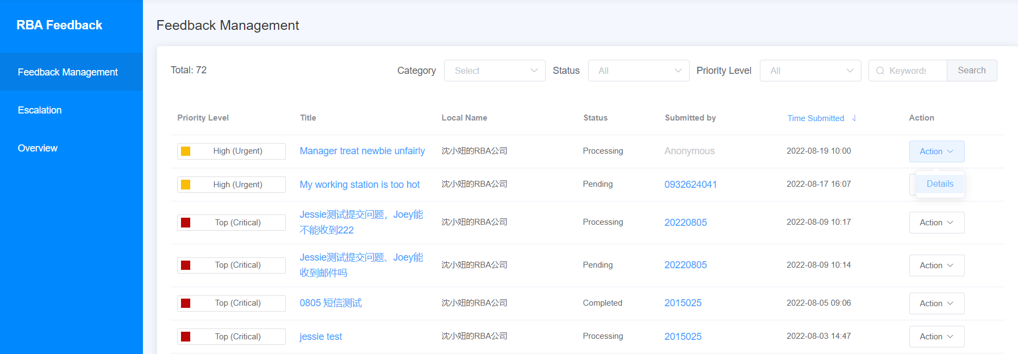
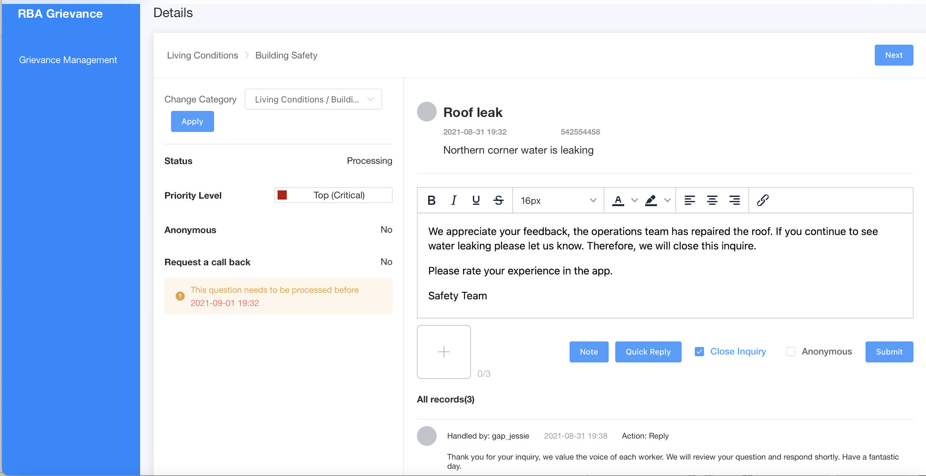
第3步。查看详情反馈信息
管理员可以点击【行动】>【细节】，查看反馈内容细节。
Notes:
(Step 3)
To view the details of the Feedback content, Admin can click on [Action]
Select [Details]

Slide 11

反馈详情1
反馈类别
员工发送的反馈内容
匿名（是/否）：
员工是否匿名发送反馈信息
要求回电（是/否）：如果员工要求工厂拨打手机号码以获得快速回复
Notes:
Here you can find:
-Feedback category
-The feedback content that was sent by the employee
-Whether this employee has sent the feedback anonymously or not
-Whether this employee requested the factory to call back his/her mobile number for a quick response or not

Slide 12
反馈详细信息2
工厂可以点击这里查看员工号或手机号
工厂可在此输入回复内容
工厂可以在此插入图片（可选）
Notes:
-Click here to view the EmployeeID or Mobile Number of employee
-This is where factory admin can type in the response
-and insert image if needed

Slide 13
反馈详情3
如果工厂在这个时段内对反馈信息作出回应，该反馈信息将在报告中被列为及时回应。
如果没有，反馈信息将在报告中被归类为逾期回复。
Notes:
According to the project guideline, this is the recommended time limit for admin to give response to this feedback.
If the factory responds to the feedback within this time period, the feedback will be classified as In-time response in the report.
If not, it will be classified as Overdue response in the report.

Slide 14
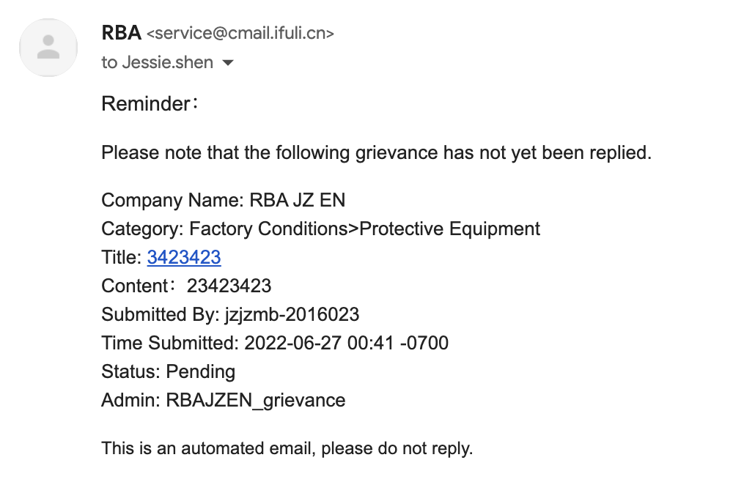
逾期回复
如果工厂没有及时回复反馈信息，系统将向工厂联络员发送一封通知邮件→点击邮件标题，您将被转到查看反馈信息。
Notes:
If the factory did NOT RESPOND to the feedback on time, the system will send a notification email to factory Point of Contact
Click on the Title in the email and you’ll be redirected to view the feedback.

Slide 15
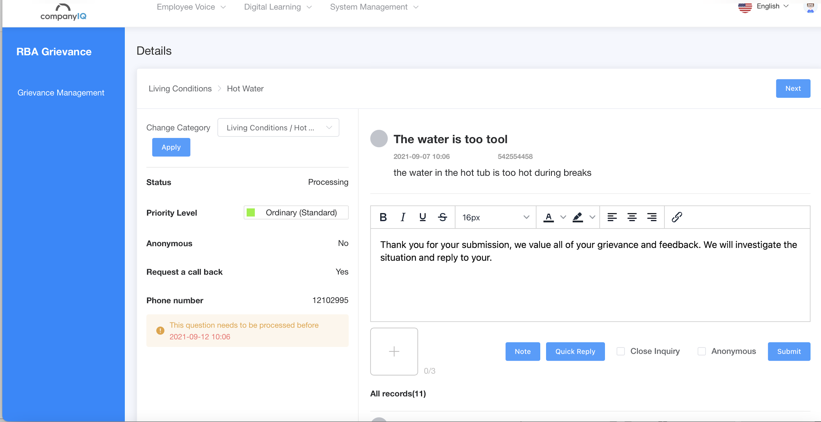
第4步。输入对工人的回应，并点击【提交】发送。
15
Notes:
(Step 4)
Type the response to worker & click [Submit] to send

Slide 16
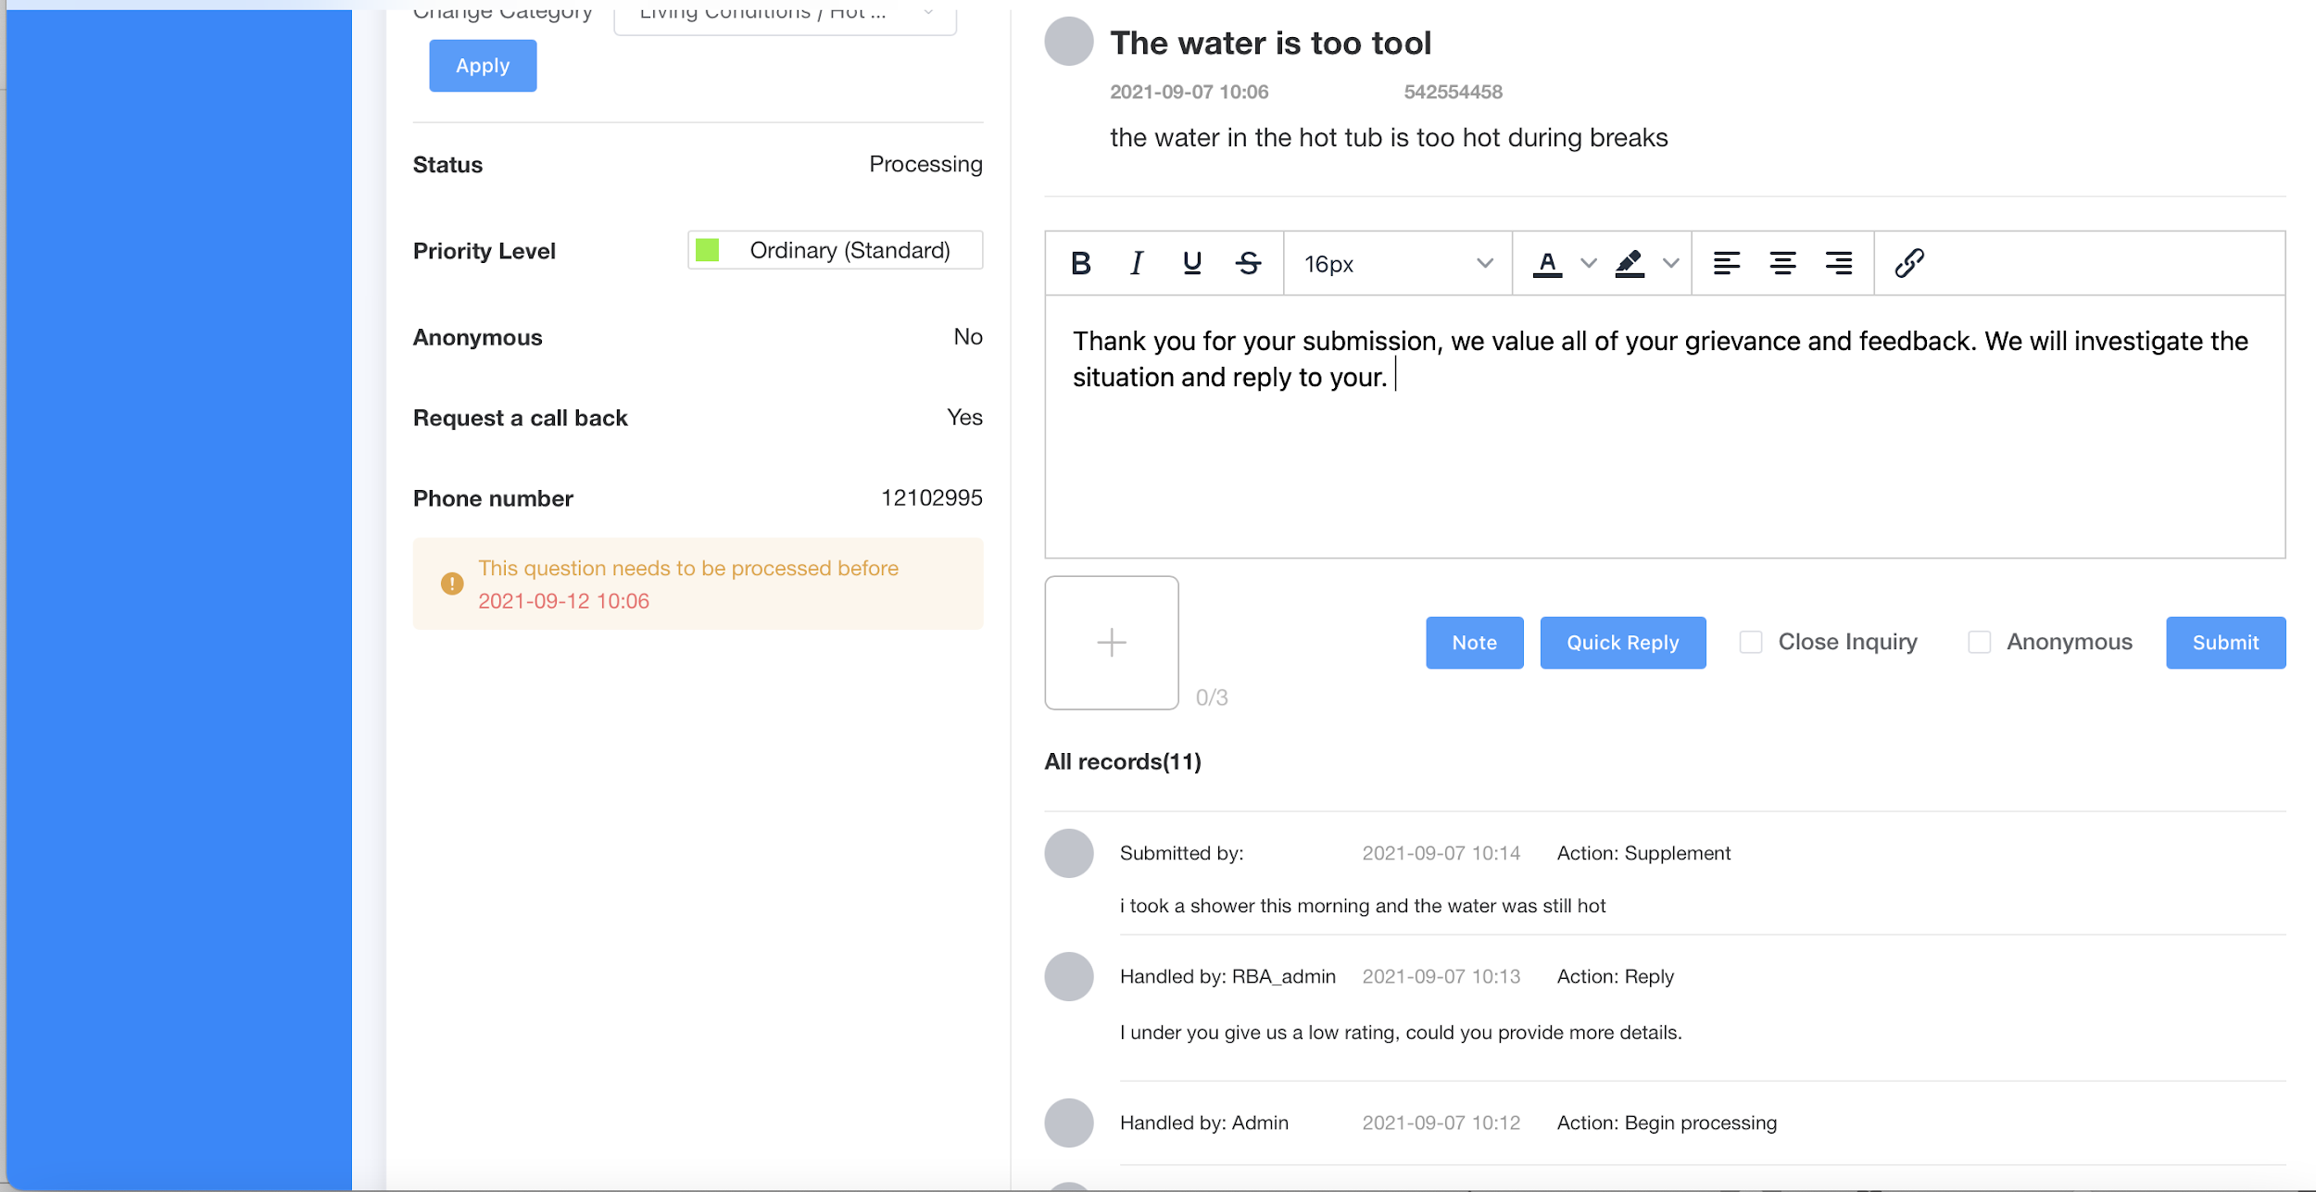
第5步。通过查看对话记录进行跟进，并
提交进一步的回应（可选）。
Notes:
(Step 5)
Follow up by viewing Dialogue Record & submit further response if needed

Slide 17
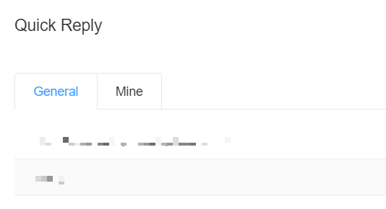
快速回复 (可选)
点击【快速回复】，生成一个新的默认回复，或将默认回复应用到反馈信息中。此举将有助于管理员对类似的反馈做出更快回应。
只有工厂管理员可以查看此备注，员工不能查看。
Notes:
Click on [Quick Reply] to generate a new default response or to apply the default response to this feedback. This will help admin to respond quicker to similar type of feedbacks.

Slide 18
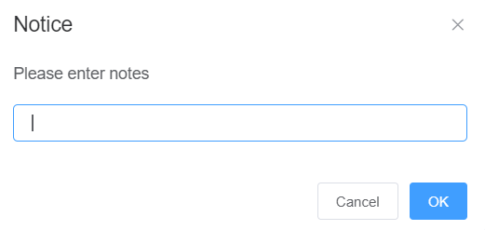
备注 (可选)
工厂管理员也可以点击【备注】来插入额外的评论供内部参考。
只有工厂管理员可以查看此备注，员工不能查看。
Notes:
Furthermore, Factory admin can also click on [Note] to insert additional comments for internal reference.
This note can only be viewed by the factory admin. Employee cannot view this note.

Slide 19
第6步。点击【关闭查询】
标记反馈信息为 "已完成"
19
Notes:
(Step 5)
Click on [Close Inquiry] to mark the feedback as “Completed”.
This step is very important. Because it indicate that the factory has solved this inquiry for the worker.

Slide 20
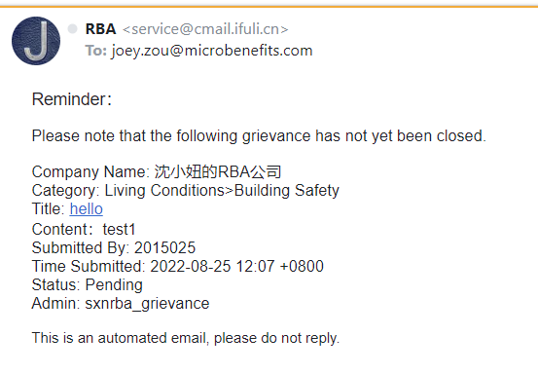
逾期关闭
如果工厂没有及时关闭反馈，系统会给工厂联络员发送一封通知邮件→点击邮件标题，就会被转到查看反馈详细信息
Notes:
If the factory did NOT CLOSE the feedback on time, the system will send a notification email to factory Point of Contact.
And that is all for this video. Thank you for watching.

