Slide 1
工厂快速指南： 后台登录
和主要功能介绍
Notes:
Welcome to Factory Quick Guide Video

Slide 2

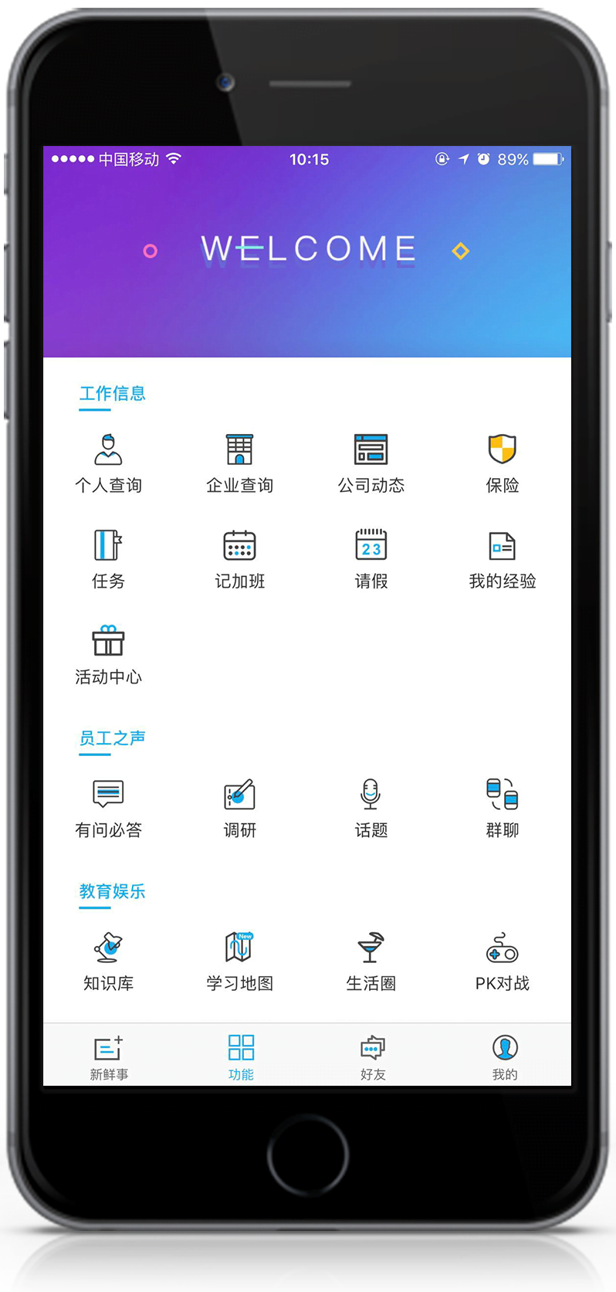

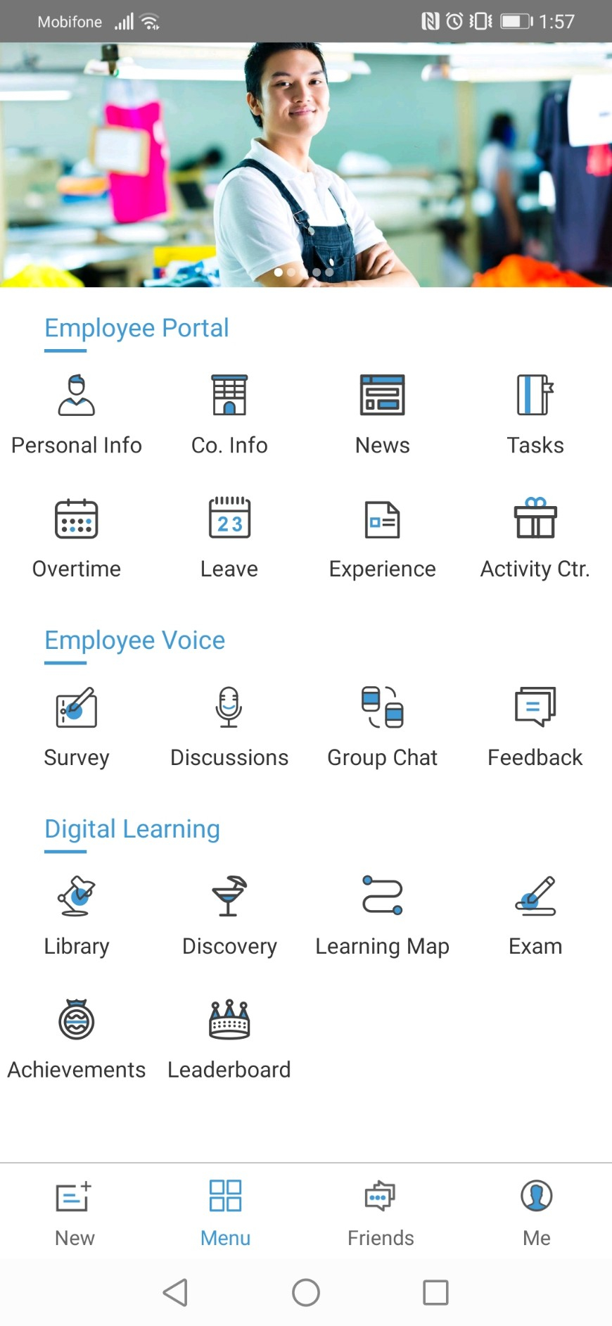
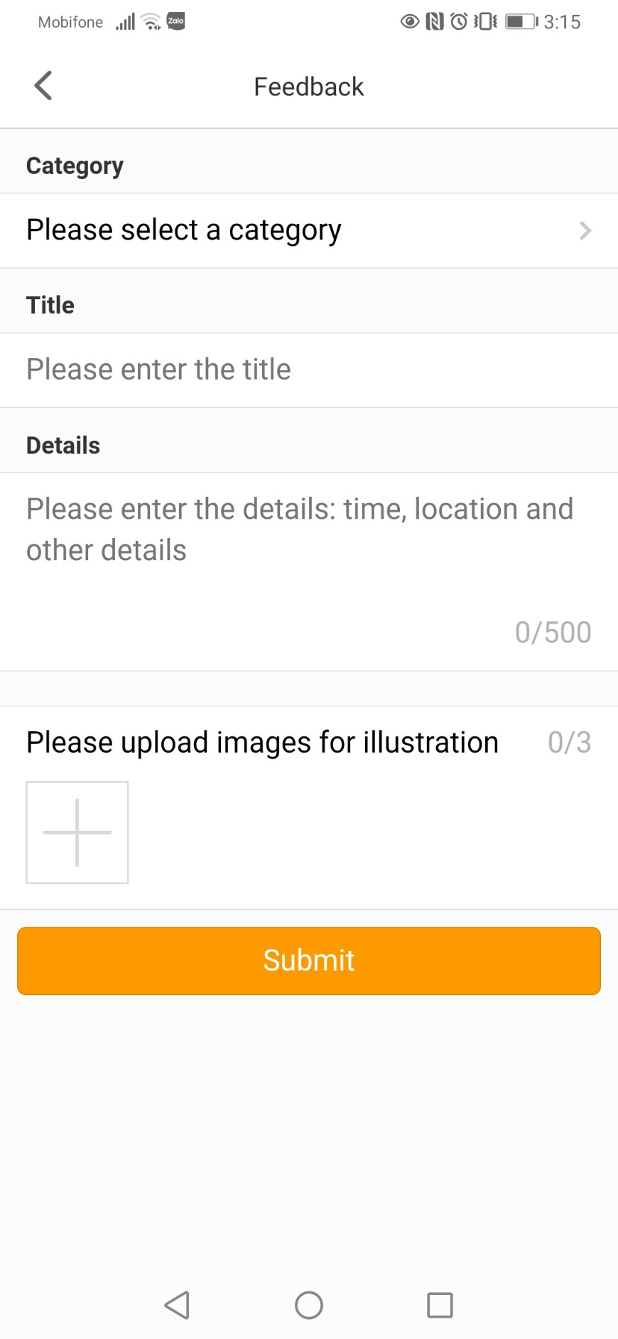
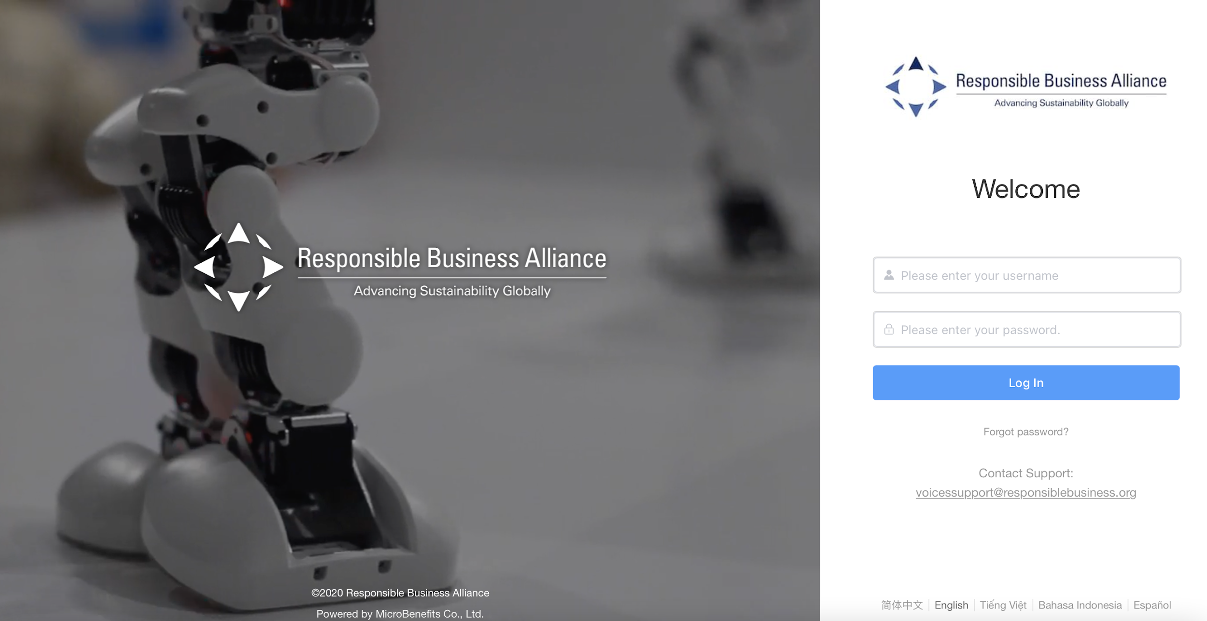
RBA反馈工具
使用智能手机
扫描二维码码
和提交反馈意见
使用电脑/笔记本通过后台网站管理和回复反馈信息
员工
工厂管理
微福利
Notes:
Within the RBA Feedback Tool, there are 2 different portals: The 1st one is for the employee & the 2nd one is for the factory admin.
Employee can submit feedback by using their smartphone to scan the QR Code
Factory admin can manage & give response to employee’s feedback through the Backend Website
In this video, we will teach you How To Login the Backend & What are the key features of the Backend?

Slide 3
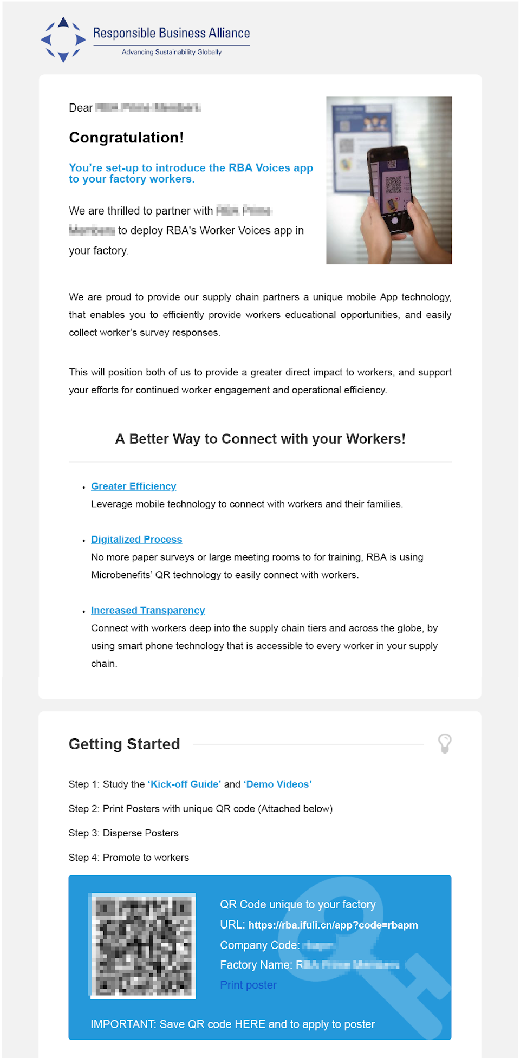

后台登录
第1步访问反馈后台并使用账号登录
登录账号
将通过电子邮件发送给您
Notes:
At the final page of the onboarding training course, you will be given an URL which direct to the Backend.
Please click on that link & login with your Login Credentials.
(show on screen the credentials in the email, enter username+password, click login)

Slide 4
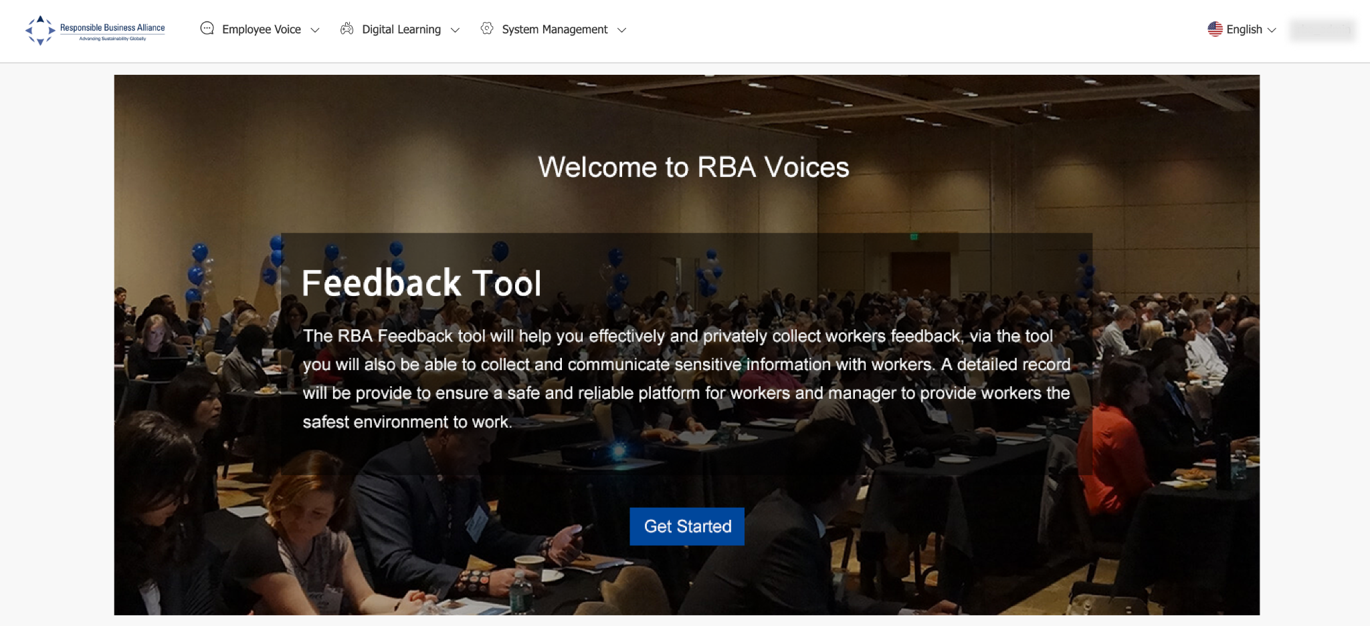
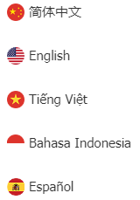
后台登录
第2步在【反馈工具】部分>点击【开始】。
如果您希望以不同的语言查看后台，请点击这里
可用语言
Notes:
If you wish to view Backend in different language, please click on this icon
Then, At the [Feedback Tool] section > Click on [Get Started]

Slide 5
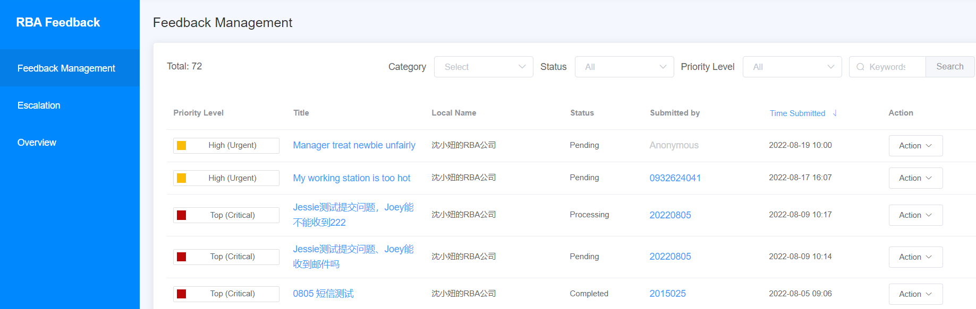
反馈管理
接下来，在这个页面上，您会发现工人提交的所有反馈信息列表。
Notes:
First, on the Feedback Management page you will find a list of all Feedback submitted by the workers. This is where the factory admin can manage & respond to the employee’s feedback. We will give you further details and instruction on how to respond to feedback in another video.

Slide 6
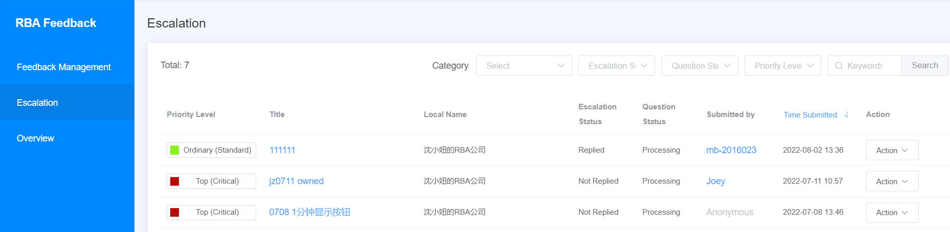
升级
"升级 "功能是什么？
谁可以查看和回复升级后的反馈？
Notes:
Next, on this page, you will find escalation feedbacks

Slide 7

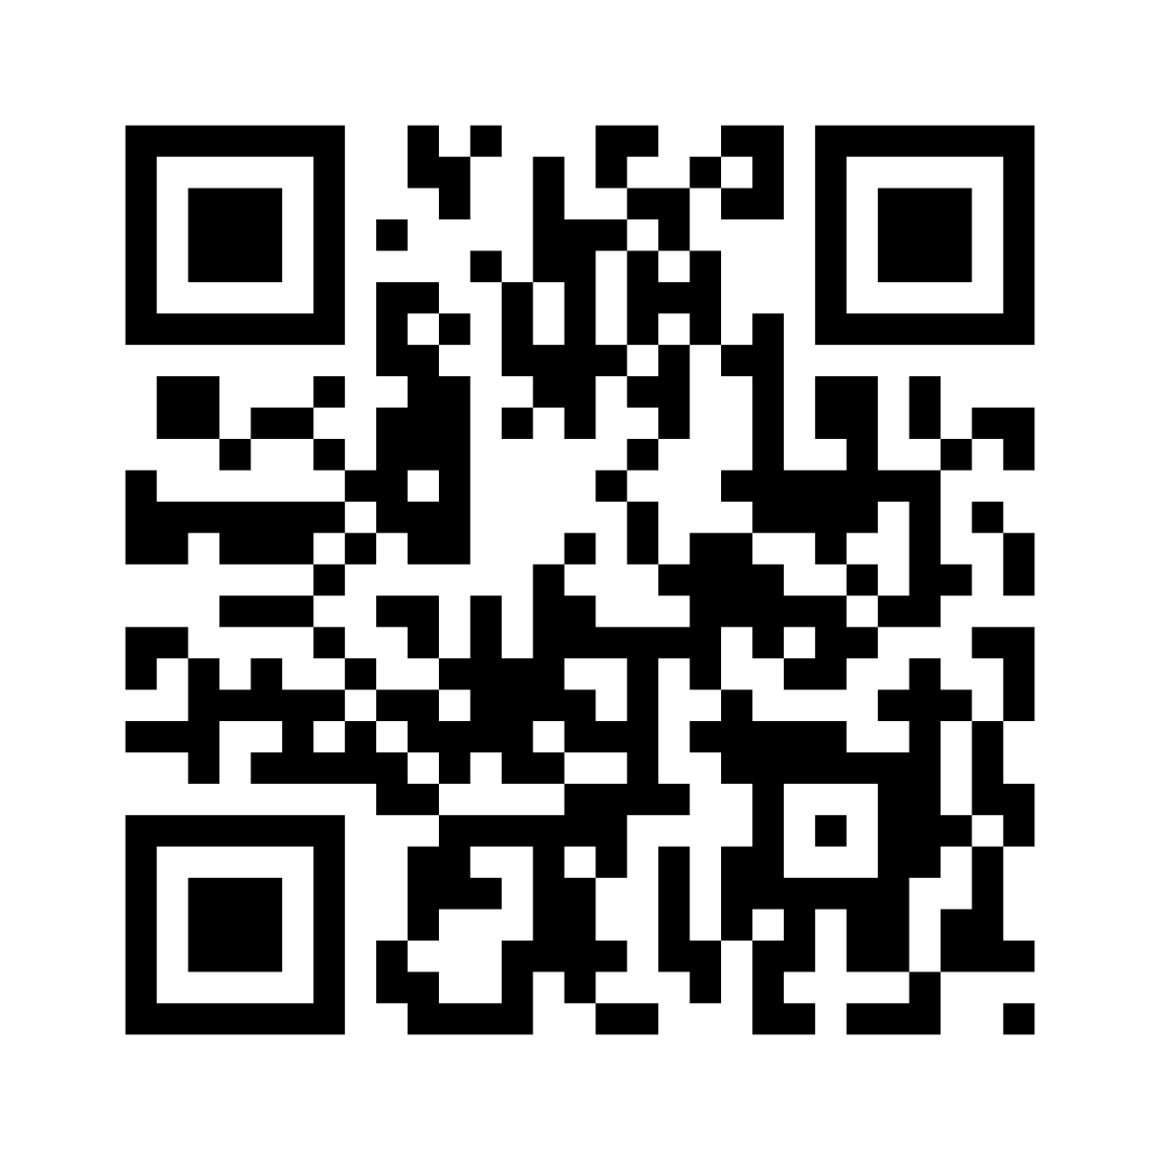
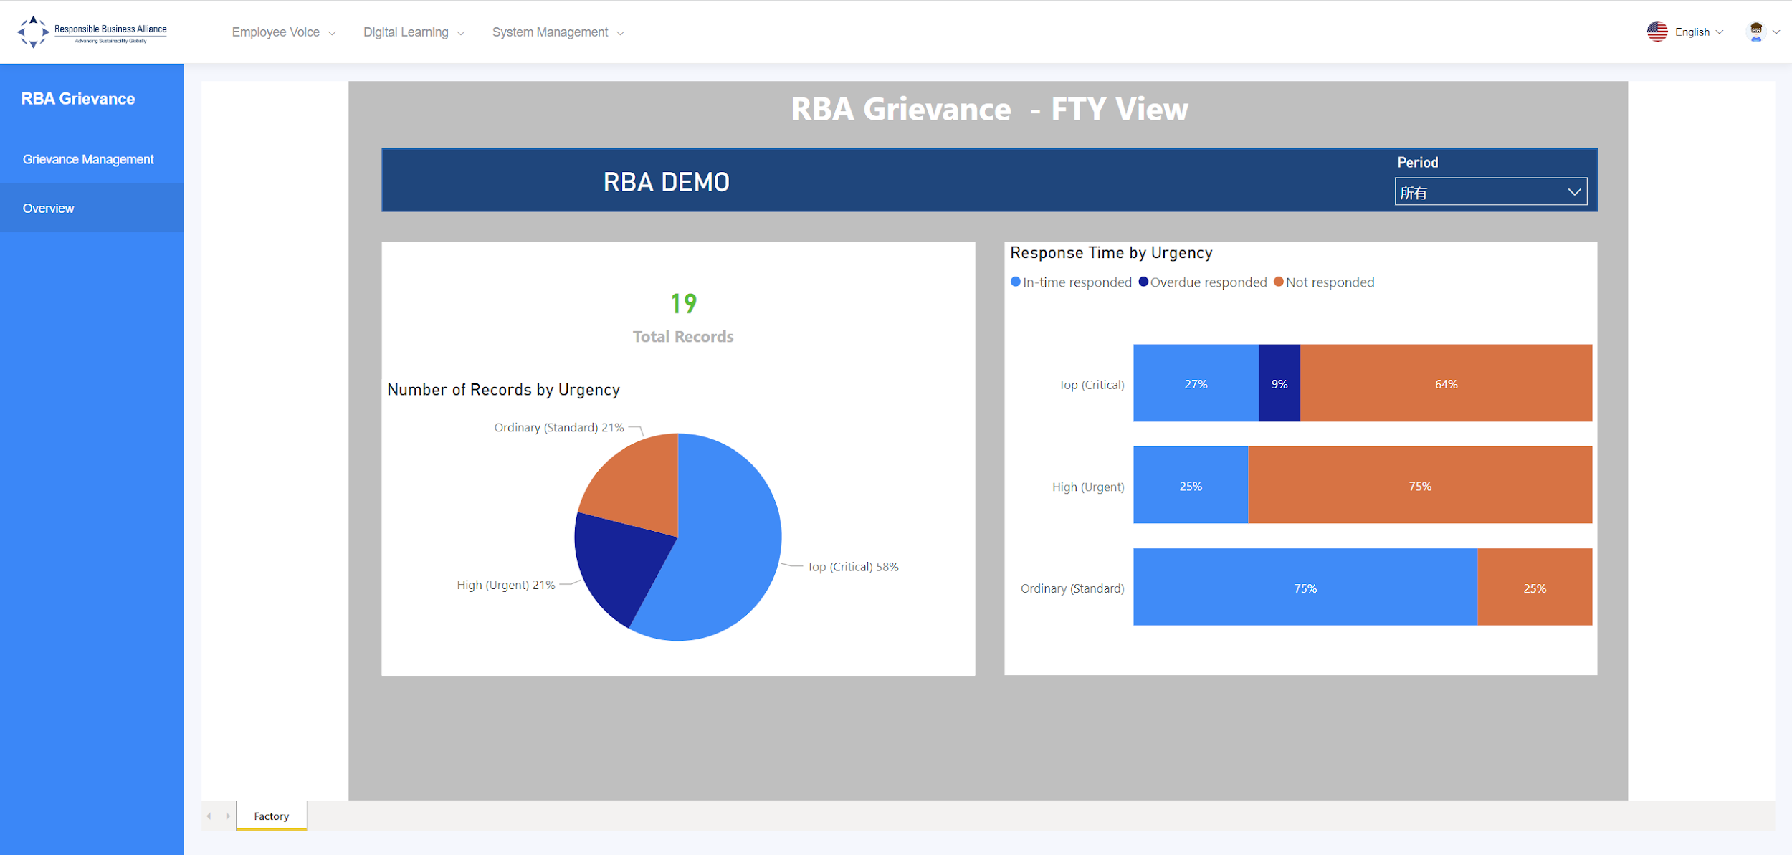
报告
工厂将反馈工具部署给员工后，系统会立即计算出提交的反馈信息数量，并为工厂生成一份分析报告。
工厂将工具部署给员工
员工提交反馈信息
工厂对反馈信息作出回应
系统记录所有的反馈对话
工厂查看分析记录
Notes:
Lastly, you can also find the feedback report on this website.
As the employees use the tool to submit feedback to the factory, the Backend system will not only record the details of the feedback, but also analyze the total number of feedback submitted by the employees and generate an Analysis Report for the Factory

Slide 8
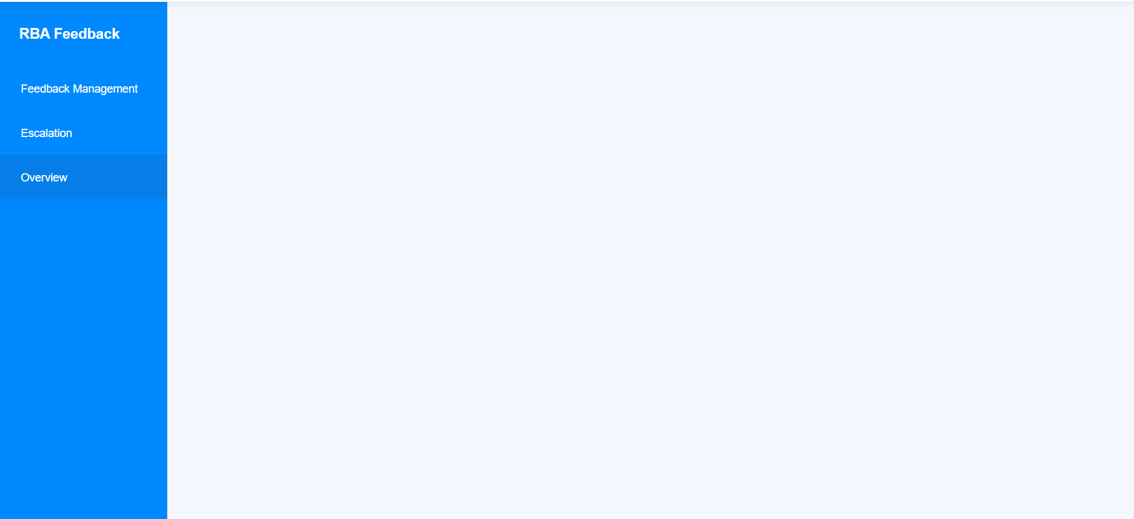
点击左边面板上的【概览】。
工厂可以在这里查看员工提交的反馈信息分析报告。
Notes:
All you need to do is go to Backend and on the left panel, click on [Overview]

Slide 9
您可以选择【时段】来查看具体报告
Notes:
and choose the Period of time you would like the system to show you.
You can check back on this report as many times as you want and anytime

Slide 10
条款描述
总记录：一段时间内提交的反馈信息总量
                普通（标准）：需要在72小时内回复低紧急反馈信息
                高（紧急）：需要在48小时内回复高紧急反馈信息
                高（关键）：非常紧急的反馈信息，需要在24小时内作出回应。
及时回复：工厂已在回复时限内对反馈信息进行了回复
逾期未回复：工厂已在回复时限之外对反馈信息进行了回复
未回复：工厂没有回复反馈意见
Notes:
If this is your first time seeing this report, here is a description of terms to help you understand how to read this report. You can pause this video here to take a closer look.
And that is all for this video. Thank you for watching.

